Slide 1

Entertainment Education as communicative strategies on Chinese social media against the infodemic of COVID-19
Yiheng Wang, University of Cadiz
Advisor: Víctor Manuel Marí Sáez
yiheng.wang@uca.es, evawang0921@hotmail.com

Slide 2

Research Background
Global crisis in multiple dimensions of economy, politics, society, and culture caused by COVID-19
The infodemic coming hand in hand with the pandemic and the omnipresence of rumors and mis/disinformation in this digital age.
Communicative strategies by the digital native young generations in Health Communication facing the complexity of the social panic on Chinese social media

Slide 3

Research Questions
1. What EE initiatives by the citizens can contribute against COVID-19 mis/disinformation among the population in the context of China?
2. How is citizen participation in these initiatives to promote health measures before COVID-19?
3. What are the narratives and communicative strategies mobilized on social media for this purpose?

Slide 4
Conceptual framework
Communication for Development (Servaes, 2002; Marí, 2020) and its subsequent evolution towards Communication for Social Change (Gumucio-Dagron & Tufte, 2006)
Culture-centered Approach (CCA) (Dutta, 2004, 2007, 2008).

Slide 5
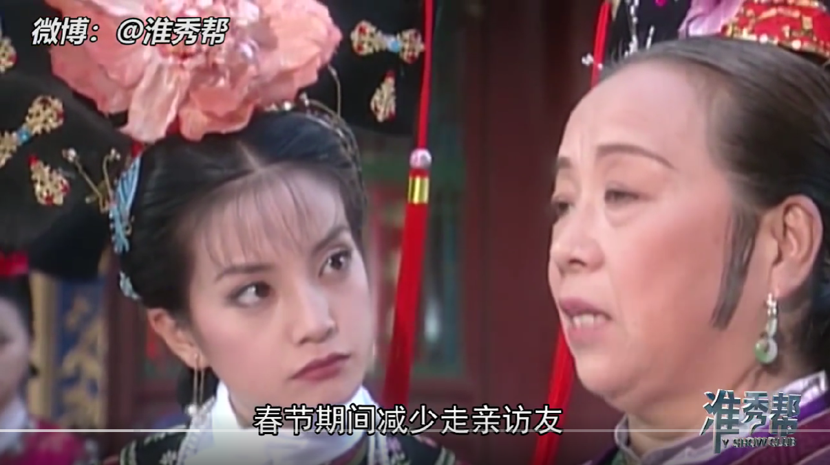
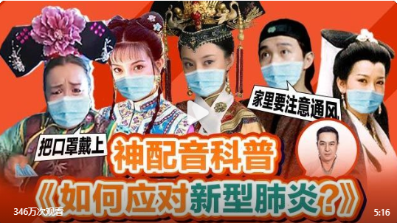
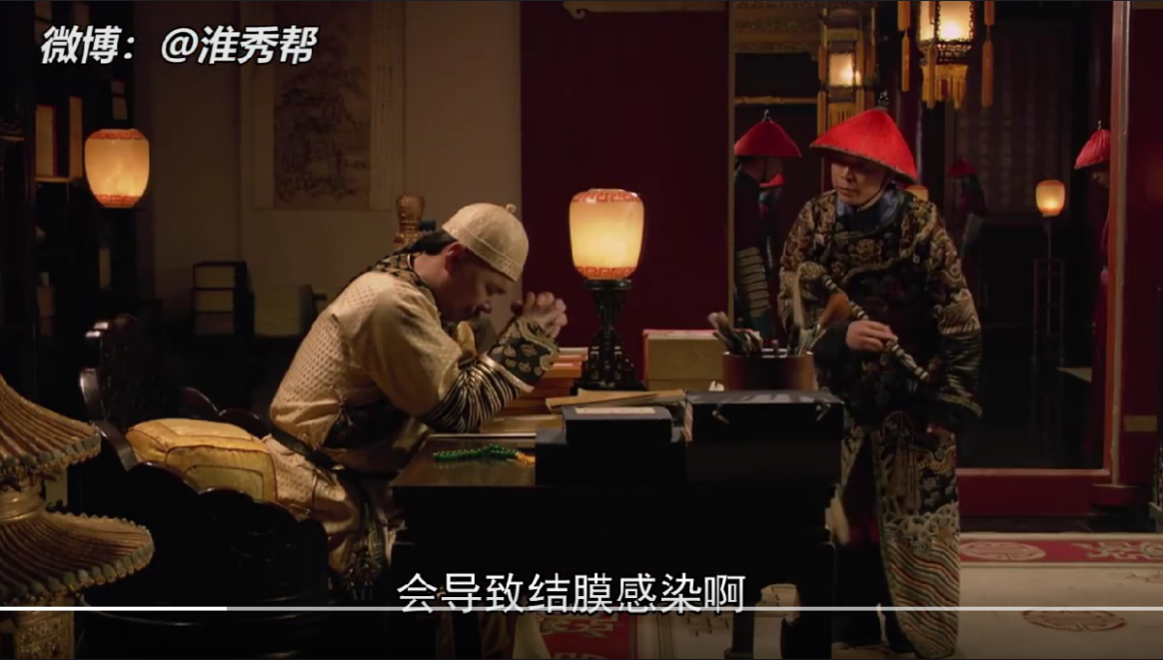

Slide 6


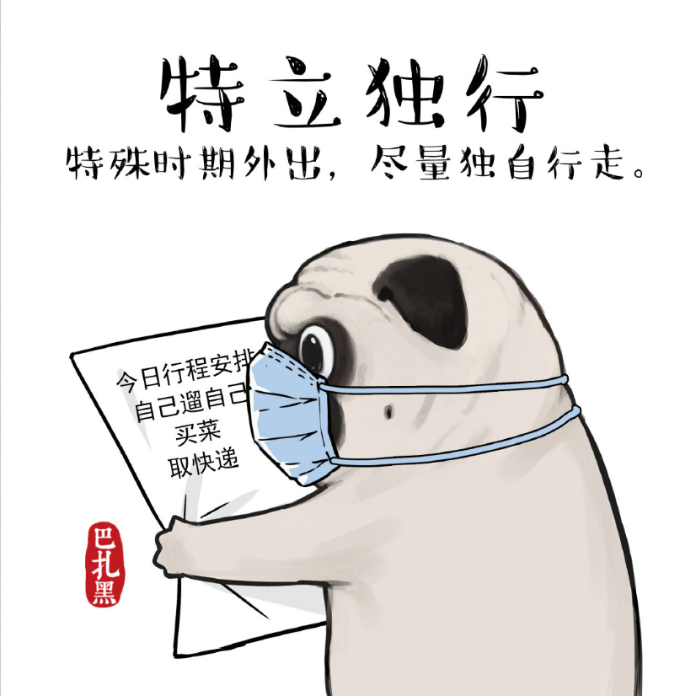
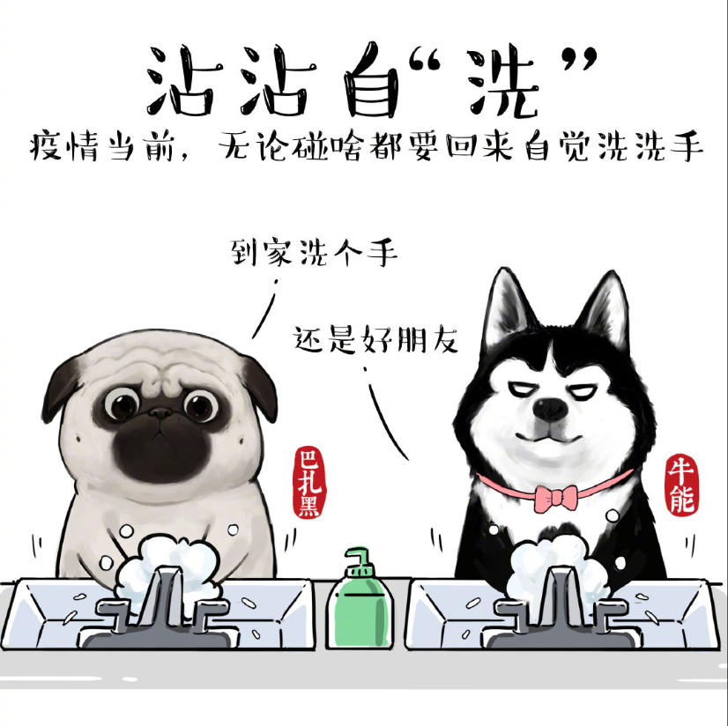

Slide 7
The axiological position and social relevance
The communicative initiatives grouped under the EE label gain special relevance, understood as a communication strategy in Health Communication to help the public enhance the efficacy of understanding, absorbing, improving, and diffusing health knowledge and take correct response through educational messages on entertainment media such as the Internet or their social media, especially in a health crisis like the ongoing COVID-19 pandemic (Dutta, 2006, Singhal & Rogers, 1999).
Face to the general public, generated by young digital native generations

Slide 8
Expected Findings
The lack of a credible voice has helped increase the impact of fake news on citizens, particularly people who do not have a good health knowledge base
Exposure to social media content from people that are close to the user significantly impacts the health behavior of social media users
An ambivalence of the EE initiatives should be taken into account

Slide 9
Questions and reflextions
The nature of entertainment of social media and the problem of over-entertaining
To form the digital literacy from taking advantages of entertainment by EE strategies and improve the over-entertaining phenomenon
Taking the social structural issues and the factors out of Health into account

Slide 10


Thank you for your attention!
Yiheng Wang, University of Cádiz
Advisor: Víctor Manuel Marí Sáez
yiheng.wang@uca.es
evawang0921@hotmail.com
Research project financed by AEI (Agencia Estatal de Investigación de España) PID2019-106632GB-I00 / AEI /10.13039/501100011033. IP: Víctor Manuel Marí Sáez. University of Cádiz

