Slide 1

Entertainment Education as communicative strategies on Chinese social media against the infodemic of COVID-19
Yiheng Wang, University of Cadiz
Advisor: Víctor Manuel Marí Sáez
yiheng.wang@uca.es, evawang0921@hotmail.com

Slide 2

Research Background
Global crisis in multiple dimensions of economy, politics, society, and culture caused by COVID-19
The infodemic coming hand in hand with the pandemic and the omnipresence of rumors and mis/disinformation in this digital age.
Communicative strategies by the digital native young generations in Health Communication facing the complexity of the social panic on Chinese social media
Research Questions
1. What EE initiatives by the citizens can contribute against COVID-19 mis/disinformation among the population in the context of China?
2. How is citizen participation in these initiatives to promote health measures before COVID-19?
3. What are the narratives and communicative strategies mobilized on social media for this purpose?
Conceptual framework
Communication for Development (Servaes, 2002; Marí, 2020) and its subsequent evolution towards Communication for Social Change (Gumucio-Dagron & Tufte, 2006)
Culture-centered Approach (CCA) (Dutta, 2004, 2007, 2008).

Slide 3
Methodological Concept:
Case studies (Snow & Trom, 2002, p.147):
Investigation and analysis of an instance or variant of some bounded social phenomenon that seek to generate a rich detailed and “think” elaboration of the phenomenon studied through the use and triangulation of multiple methods or procedures that include but are not limited to qualitative techniques”.
Content analysis (Berelson 1952, p.18; Holsti, 1969, p.14):
A research technique that objectively, systematically and quantitatively describes the manifest content of communication, that can be inferred by objectively and systematically identifying the specific characteristics of information.

Slide 4

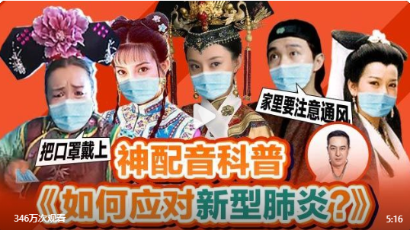
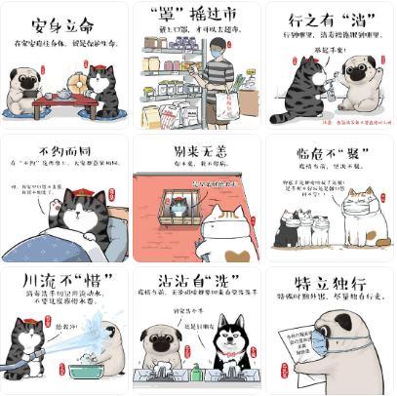
A campaign of dubbing parody video by Y Show Club
A series of cartoons by Baicha

Slide 5
Data Collection:
Case selection: on Sina Weibo (Mainstream Chinese social media) from 1st January 2020 to 31st March, 2020.
Selection criterion: the Best Diffusion winners in the collection of the solicitation for creative digital contents named Help Fight against the Pandemic with People’s Creation (16th of February- 15th of March in 2020) organized by the Coo.people.cn, which is a platform created by People.com owned by People’s Daily
Data and elements of analysis:
The data of post time, number of reposts/comments/likes, and the top 50 hot comments
Narrative, content form, culture elements and other content characteristics

Slide 6
Data Analysis:
Dubbing parody video by Y Show Club:
Account profile:
A group of young volunteers of 80’ and 90’s generations who are fund of the classic Chinese series and willing to share their ideas of the hot social issues by their lifelike dubbing skills, without official or medical expert background.
Up to 2019, the team had more than 10 million followers on Sina Weibo, Tic Tok, YouTube and other social media platforms in total.
Data of content:
Almost 3,5m views, 7983 reposts and 14651 likes.
Attitude and sentiment of the user feedback (comments):
The comments of this Weibo show a major positive attitude and clear message of willingness for spreading the message out.

Slide 7
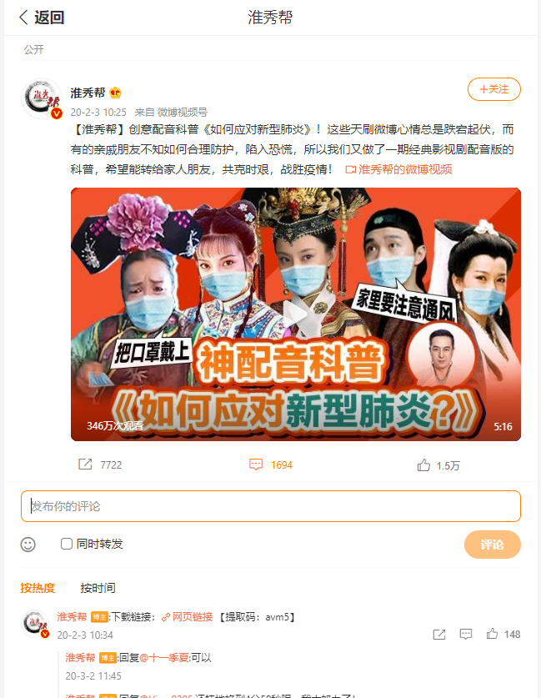
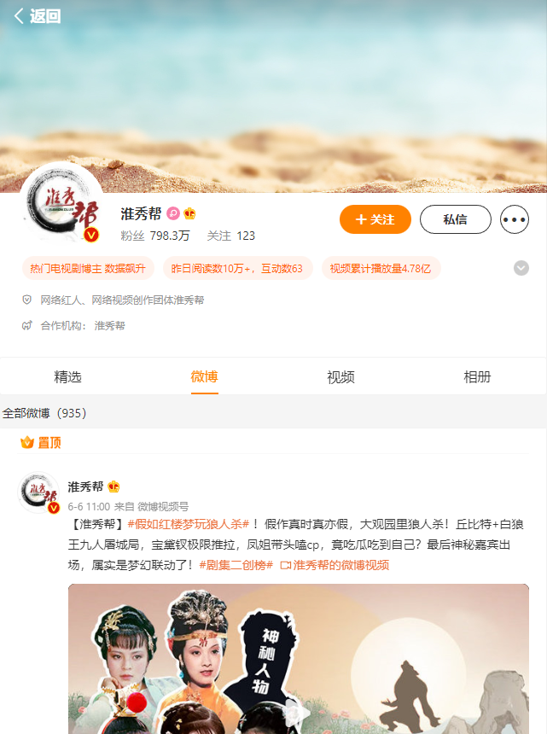

Slide 8
Data Analysis:
Dubbing parody video by Y Show Club:
Several classic and unforgettable Chinese series and movie clips that accompany the public for generations with the replacement of the original lines by COVID-19 prevention measures by jokes and parady storytelling narrative:
My Fair Princess (1998),
Hail the Judge (1994)
Empresses in the Palace (2011)
ER Doctors (2017)
A Chinese Odyssey Part One: Pandora's Box (1995)
The Legend of White Snake (1992)
In the end of video, the production team also incorporated their reminds and kind words to audience as well as the official source from where they conceived the health information and prevention measures, which is Committee of Chinese Medical Doctor Association.

Slide 9
Data Analysis:
Cartoon by Baicha:
Account profile:
One of the most popular cartoonists on social media platformsreator and the author of the cartoon series I Like that You Don’t Like What I Do, But Can Do Nothing about It, with the leading protagonist his cat Wuhuang, his dog Bazhahei and their friends cat Aobai and dog Niuneng.
Over 5m followers on Sina Weibo
Data of content:
5295 reposts and 16146 likes.
Attitude and sentiment of the user feedback (comments):
In the comments, it shows a major attitude of affection of the figures in those illustrations, while there’re also some comments clearly expressing their consensus of the content and willingness of reposting for both the intentions of helping people around them protect themselves and relieving the fear, anxiety and confusion of the coronavirus by learning correct health information.
There’s also comment saying that she’s reviewing the illustrations again here right after checking up the same content on his official account in another social media platform WeChat.

Slide 10
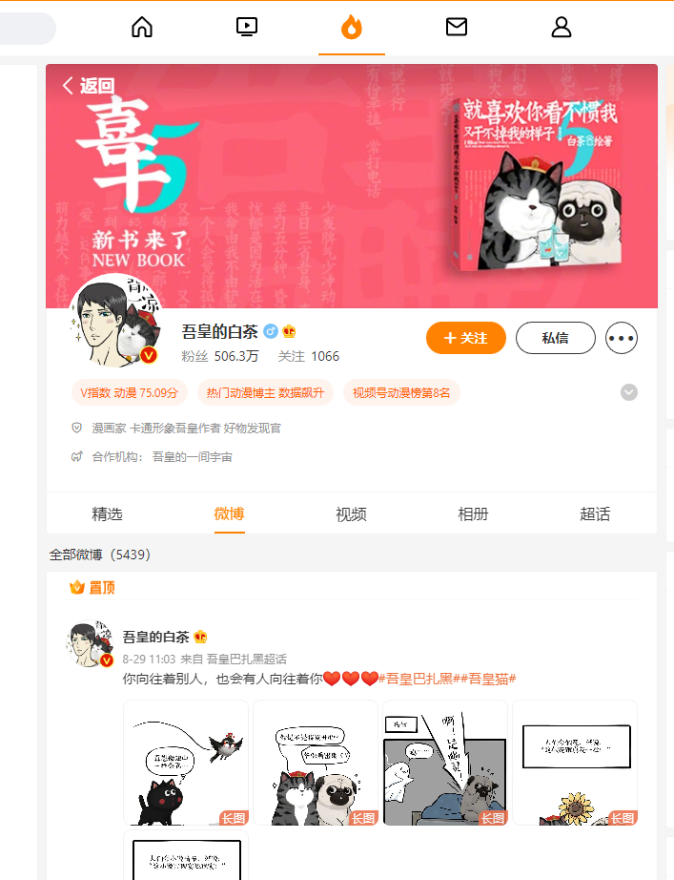
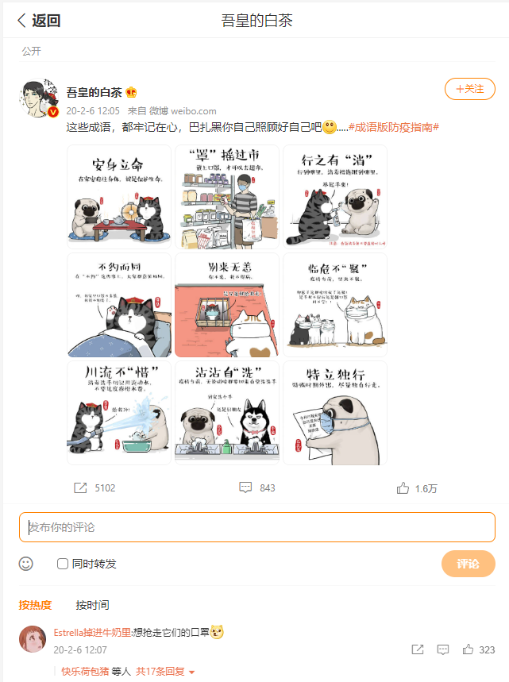

Slide 11
Data Analysis:
Cartoons by Baicha:
Nine frequently used Chinese idioms transformed and re-explained with the COVID-19 prevention measures into the cartoons of the daily story between those adorable little animals in the typical tune and comic narrative of each figure according to their characters.
A framing that drive the tranquility and relaxation
The precautions in the prevention measure also were explained in the cartoon, for example, the use of sterilizing products.
The figures are created of his pets in the real life.
A relaxed emotional base of trust from cartoons in a context of great anxiety, provoked in Chinese citizens by social distancing, by the existing misinformation in the face of the rapid spread of a largely unknown disease such as COVID-19 and by the consequent anxiety that this situation generates.

Slide 12
Methodological choices
Case studies make it possible to promote exploratory work based on inductive processes carried out in their real contexts (Yin, 2009) in which emerging phenomena can be investigated. It allows to put the citizens as the central roll to observe the phenomenon and to seek the solutions behind of the everyday life.
Literacy in digital forms in the cyberspace, not only the literacy of being digital.
A capacity to speak and listen to others and the mean to achive it.
Researchers stay “outside”, don’t invervene nor interact with the participants but observe in “distance”.

Slide 13
Epistemological positions
Rooted in regional culture and their user habbits
Central and active roll of citizens
Observation objectively as a third party
The concept of "think", applied to qualitative research, has a special resonance in the work of the anthropologist Clifford Geertz (1973) known for his contribution on "dense descriptions" which, in ethnographic work, allow us to identify the web of meaning and conceptual structures in which it is possible to frame certain facts and observations.
In this line, our research also bears in mind the contributions of digital ethnography (Pink et al., 2016) insofar as it assumes a "non-digital centric" attitude, namely, a distance from the analysis centered on technological tools and, as an alternative, an emphasis on the study of "the social" as it is present in digital spaces, an emphasis more on mediations than on the media (Martín Barbero, 1993).

Slide 14
Questions and Reflections
How can I really “Being there” in a sphere like open forum or social media as a “outsider”
How can I identify the authenticity of users’ feedback?

Slide 15


Thank you for your attention!
Yiheng Wang, University of Cádiz
Advisor: Víctor Manuel Marí Sáez
yiheng.wang@uca.es
evawang0921@hotmail.com
Research project financed by AEI (Agencia Estatal de Investigación de España) PID2019-106632GB-I00 / AEI /10.13039/501100011033. IP: Víctor Manuel Marí Sáez. University of Cádiz

