Slide 1
Antecedents of Financial Information Literacy and Financial Management Behavior of University Students: Social Cognitive Perspective
​​Presented By:
Tabassum Aslam
Ph.D. Scholar, Institute of Information Management, Punjab University, Lahore
Librarian, Lahore School of Economics, Teaching Research & Resource Center-3 (Social Sciences), & Case Study Unit,
E-mail: tabassum@lahoreschool.edu.pk, E-mail: tabassumaslam5@gmail.com,

Slide 2
Contents
Financial Literacy?
Problem Statement
Aim & objectives
Conceptualizing FIL
Theoretical Framework
Axiological Position
Societal Relevance
Expected Results
Contribution/Implications

Slide 3
Financial
Literacy/ knowledge?
As one’s understanding and knowledge of financial concepts. | (Fox et al., 2005)
Refers to the individual’s ability to interpret and understand basic financial concepts and apply that financial knowledge to make informed decisions. | (Remund, 2010).
Understanding the financial facts, concepts, principles, and technological tools, that are critical for sound financial decision making. | (Lusardi, Thaden & Rookey, 2005)
The ability to use knowledge and skills to manage financial resources effectively for a lifetime of financial well-being”. | Hung et al., (2009, p. 4)
A person’s ability to obtain, understand and evaluate the relevant information essential to make financial decisions, with a focus on the awareness of the likely financial consequences | Mason & Wilson, 2000).
A combination of awareness, knowledge, skills, attitude, and behaviors necessary to make sound financial decisions and ultimately achieve individual financial wellbeing. | OECD, 2000

Slide 4
Social Issue/
Problem Statement
Constantly evolving complex financial information landscape
To combat financial crisis
Developing countries & financial illiteracy
Need Appropriate financial education/training
Understand their current FIL competencies
Less explored, comparatively emerging new research area

Slide 5
Research Aim
Therefore, based on the above discussed scenario my doctoral aims
To examine the financial information literacy (FIL) level of the university student. Also, it aims to understand how learning of financial information literacy among students is affected by cognitive, behavioral, and environmental factors through social cognitive theory (Bandura, 1986).

Slide 6
Research
Objectives
To examine the financial information literacy (FIL) level of university students.
  • To examine the influence of personal, cognitive factors, effective factors in predicting university students’ financial information literacy.
  • To examine the influence of behavioral factors predicting university students’ financial information literacy.
  • To examine the influence of environmental factors predicting university students’ financial information literacy.
  • To determine the relationship between financial information literacy and the outcome variable (personal finance management behavior).

Slide 7
Conceptualizing
FIL
Financial Information Literacy
Information Literacy (information competencies, Identify, Plan & Gather, Evaluate, Manage, Use information)
Financial Literacy [{(Financial knowledge (personal finance domain) and skills)]
“financial information literacy (FIL) as possession of knowledge, skills and competencies that people develop to seek, comprehend, evaluate and use financial information and concepts to make informed financial decisions to achieve ultimate financial wellbeing”
Identify
Identify the need and context of financial information
Ability to identify existing knowledge gaps
Plan and Gather
Ability to locate and access financial information
Evaluate
Ability to compare and evaluate financial information sources
(compare prices, interest rates)
Manage
Use
Ability to consider ethical & legal issues associated with financial data (privacy & security concerns)
Ability to use financial information for financial decision making

Slide 8

Theoretical Framework
The current study will investigate financial information literacy, through broad theoretical perspectives such as social cognitive theory.
Albert Bandura (Canadian-American psychologist)
In 1960 social learning theory (SLT), also known as observation learning theory
SLT believes that people can acquire new behaviors by observing and imitating others in a social context.
It acknowledges the importance of observing, modeling, and imitating the behaviors, attitudes, and emotional reactions of others.
Social Cognitive Theory 1896.

Slide 9
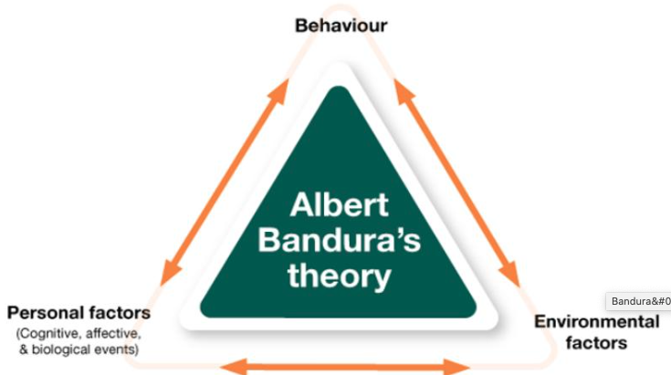
Social Cognitive Theoretical Perspective
Upgraded version of SLT,
Acknowledges the important of Self-efficacy
Provide mechanism to understand the human behavior in a social context.
The SCT offers the conceptual underpinning to look at the determinants and mechanisms of human thought, affect, and action (Bandura, 1986).
Rooted in the notion of human agency, the social cognitive theory assumes that individuals can affect what they do and are influenced by their observations and relation with their external environments (Bandura, 1986).
SCT assumes that human functioning is influenced by personal/ cognitive determinants, behavioral, and environmental determinants (Bandura, 1986, 1997).
Source: Adapted from Social Foundations of Thought and Action: A Social Cognitive Theory (p.6) by (Bandura, 1986)

Slide 10

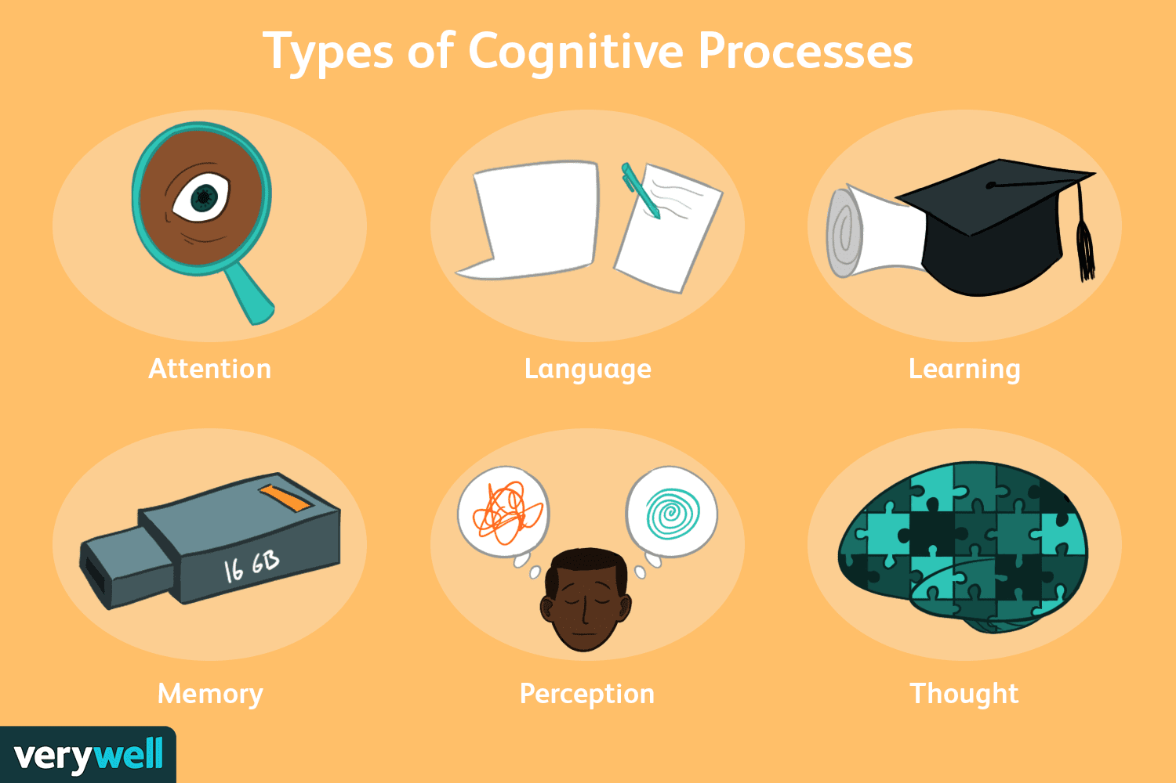

Personal factors
  Demographic
  Age, Gender, Sector Level, CGPA, Education Level, Discipline of Study, Place of Residence, Work Experience, Owning a Bank Account,
  Socio-Economic
  Parent’s education level (father/mothers)
  Monthly Income of Parents (father/mother)
Biological Factors
Biological/Personnel
Cognitive
Effective factors
  Prior Knowledge/ Financial Education
  Money Attitude
  Financial stress
Cognitive Factors
Effective Factor

Slide 11
Behavioral
Factor
Financial Self-efficacy
Financial self-efficacy is the level of confidence an individual has in his ability to access, use financial products or services, undertake a financial decision, and deal with a complex financial situation. Similarly, others describe financial self-efficacy as one’s confidence in their ability to manage their finances (Glenn, 2018).

Slide 12
Environmental Factor
Financial Socialization
Financial Socialization is a process that involves learning and advancing values, knowledge, norms, standards, attitudes, and behaviors that support the financial capability and well-being of the individual (Danes, 1994).
This process can be done through the internal or external environment called the financial socialization agents. There are four major agents of financial socialization such as parents, education, friends, and the media.

Slide 13
Personnel Finance Management Behavior
Gaining an understanding of one’s financial situation to make the most of your assets in daily life and to plan for one’s future. It also refers to effective money management, to ensure short and long-term financial security by using its numerous forms (Patrisia & Fauziah, 2019).
Xiao et al., (2014) defines financial behavior as any human behavior which is pertinent to money management. In the same way, Dowling et al., (2009) view the financial practice as a set of behaviors containing; financial planning, cash management, credit management, investments, insurance, and retirement planning, etc.
Existing literature reveals that personal finance is highly related to financial literacy and financial behavior (Altfest, 2007; Tyson, 2010).
Improved financial knowledge can encourage positive financial behavior among individuals (Hilgert, et al., 2003; Xiao, et al., 2014).

Slide 14
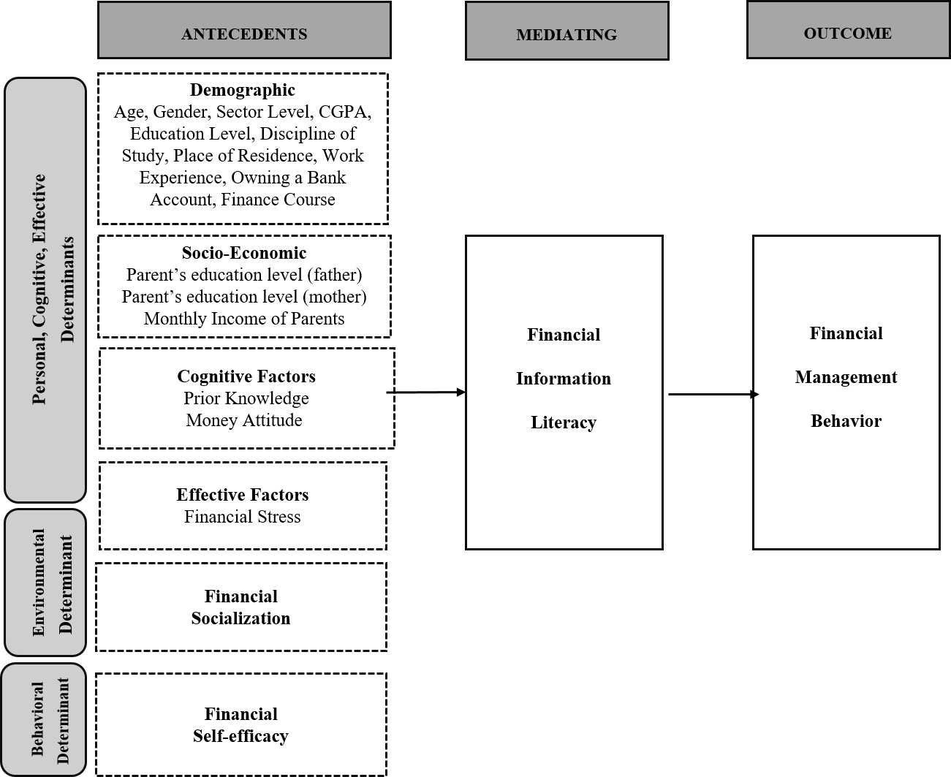
Present Study’s Theoretical Framework
Grey boxes Shows the Application of Social Cognitive

Slide 15
Axiological Position
Based on my study’s nature of philosophy (Post-positivism)
Post-positivism’s axiological positioning relates with value free axiology, or the researcher’s role is independent from the data (biased-free)

Slide 16
Societal Relevance
Improved financial decision making
Effective use of money
Reduce poverty
Ensure wellbeing
Won’t fall for fake schemes
Increased confidence
Increase financial inclusion
Economic Growth
How FIL contribute to society?/ How FIL is useful outside academia?

Slide 17
Expected
Results
The expected outcomes of the study will provide insights about students’ own perception of their current financial information skills and competencies
Expected results will identify that how various personnel, behavioral and environmental factors contributes to the FIL level of the university students. Highlights their potential problematic areas.
Expected results will identify the how FIL competencies effect university student’s personal financial management behavior.

Slide 18
Contributions/Implication

Slide 19
Theoretical
Contributions
Application of SC lens is missing in literature
Act as baseline study
Identify Potential Research Gaps
Addition in the Literature of Information Science & Management

Slide 20
Practical
Contributions
Policy makers can think about incorporating relevant curriculum (FIL) content in the general education curricula.
Emerging role of information professionals
Role of Libraries / professional organizations/ iSchools to conduct trainings/ seminars/ workshops
Provide insights for Information Science researchers
Raised awareness among students, at least, they can start to think about the importance of FIL.

Slide 21
Thankyou!

