Slide 1

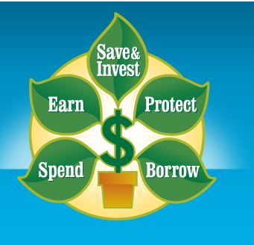

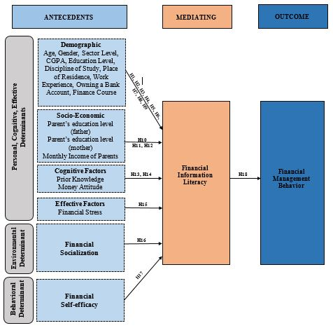



Antecedents of Financial Information Literacy and Financial Management Behavior of University Students: Social Cognitive Perspective
Background
Pakistan is a developing country, and a major part of its population belongs to the lower-middle and lower economic classes.
To overcome the social and financial crisis, literacies play a significant role. Financial education/training/ literacy is imperative for the survival of generations suffering from COVID-19 and such pandemic situations.
Therefore, to provide appropriate financial education and training is extremely important to understand people’s current financial information literacy level. Also, Youth (especially students) considers the backbone of any society. Pakistan’s most population consists of youth.
Conceptualizing Financial Information Literacy
Information Literacy (information competencies, Identify, Plan & Gather, Evaluate, Manage, Use information)
Financial Literacy [{(Financial knowledge (personal finance domain) and skills)]
Identify
Identify the need and context of financial information
Ability to identify existing knowledge gaps
Plan and Gather
Ability to locate and access financial information
Evaluate
Ability to compare and evaluate financial information sources
(compare prices, interest rates etc.)
Manage
Use
Ability to consider ethical & legal issues associated with financial data
(privacy & security concerns)
Ability to use financial information for financial decision making
Research Problem
Expected Results
Therefore, my doctoral aims to examine the financial information literacy (FIL) level of the university student. Also, it aims to understand how learning of financial information literacy among students is affected by cognitive, behavioral, and environmental factors through social cognitive theory (Bandura, 1986).
The expected outcomes of the study will provide insights about students’ own perception of their current financial information skills and competencies
Expected results will identify that how various personnel, behavioral and environmental factors contributes to the FIL level of the university students.
Expected results will identify the how FIL competencies effect university student’s personal financial management behavior.
Theoretical Framework
Research Objectives
Main Objective
To examine the financial information literacy level of the university students
Sub-Objectives
To examine the influence of cognitive factors i.e. (personal, cognitive, and affective) in predicting university students’ financial information literacy.
To examine the influence of behavioral factors predicting university students’ financial information literacy.
To examine the influence of environmental factors predicting university students’ financial information literacy.
To determine the relationship between financial information literacy and the outcome variable personal finance management behavior.
Research Philosophy
Post-Positivist Paradigm
Reductionist, Determinism, Relationship
Research Approach/ Methods
Quantitative
Survey
Population/ Sampling
Undergraduate/ postgraduate Students (social science discipline, HEC recognized top ten general universities (public/ private) of Lahore
Purposive sampling
Data Collection/ Analysis
Questionnaire
SPSS-22 and AMOS to test the model and hypotheses.
Policy makers can think about incorporating relevant curriculum (FIL) content in the general education curricula.
Emerging role of information professionals
Role of libraries / professional organizations/ iSchools to conduct trainings/ seminars/ workshops
Provide insights for Information Science researchers, future research recommendations
Raised awareness among students, at least, they can start to think about the importance of FIL.
Research Design
Implications/ Contributions
Presenter: Tabassum Aslam
Ph.D. Scholar: Institute of Information Management, University of the Punjab, Pakistan, Lahore
Librarian: Lahore School of Economics, Teaching Research & Resource Center-3 (Social Sciences)
: tabassum@lahoreschool.edu.pk , tabassumaslam5@gmail.com, tabassumaslam.aslam
​​

