Slide 1


Quantitative Measures to Financial Information Literacy
Supervised By:
Prof Dr. Khalid Mehmood, IIM, Dr. Syeda Hina Batool
​​Presented By:
Tabassum Aslam
Ph.D. Scholar, Institute of Information Management, Punjab University, Lahore
Librarian, Lahore School of Economics, Teaching Research & Resource Center-3 (Social Sciences), & Case Study Unit,
E-mail: tabassum@lahoreschool.edu.pk, E-mail: tabassumaslam5@gmail.com,

Slide 2
Contents
Problem Statement/ Formulation of Research Question
Quantitative Research Design
  Research Philosophy/
  Paradigms
  Research Method
  Why Survey Method (relevancy to the RQ)
  Relationship to the Research Participants
  Population/Sampling
  Data collection/Analysis

Slide 3
Problem Statement/ Formulation of Research Questions
Browse, search & review related Literature (financial literacy, financial knowledge, adults, youth, Pakistan’s Perspective)
Narrow down a the specific research questions
(What is the FIL level of university students, how learning of FIL is effected by certain factors)
Formulate
Research question, H
based on
existing
literature
Starts with a general topic i.e. Financial Literacy

Slide 4
Quantitative
Research Design
Research design incorporates plans and procedures to collect, analyze, interpret, and report the data in research studies. Research designs represent diverse models to conduct research, and these models are characterized by different names and follow dynamic associated procedures such as quantitative research, qualitative research, and mix methods.
The nature of the understudied phenomenon also helps to decide an appropriate research approach, philosophy and methodology to achieve the research objectives.

Slide 5
Research
Design
Research Philosophy
Post-Positivist Paradigm
Reductionist, Determinism, Relationship
Research Approach/Methods
Quantitative
Survey
Population/Sampling
Undergraduate/ postgraduate Students (social science discipline, HEC recognized top ten general universities (public/ private) of Lahore
Purposive sampling technique
Data Collection/Analysis
Questionnaire
SPSS-22 and AMOS to test the model and hypotheses.

Slide 6
Research Philosophy/
Paradigms
Research philosophy is composed of beliefs and assumptions about knowledge that researchers bring to their inquiry in their study
This will help researchers to explain why they choose specific research approaches (quantitative, qualitative, and mixed-methods approaches) to achieve the objective of the underlying study.
This philosophical positioning is represented by the term called a worldviews/ Paradigms
Four research paradigms worldviews: post-positivism, constructivism, advocacy/ participatory, and pragmatism (Creswell & Clark, 2017)

Slide 7
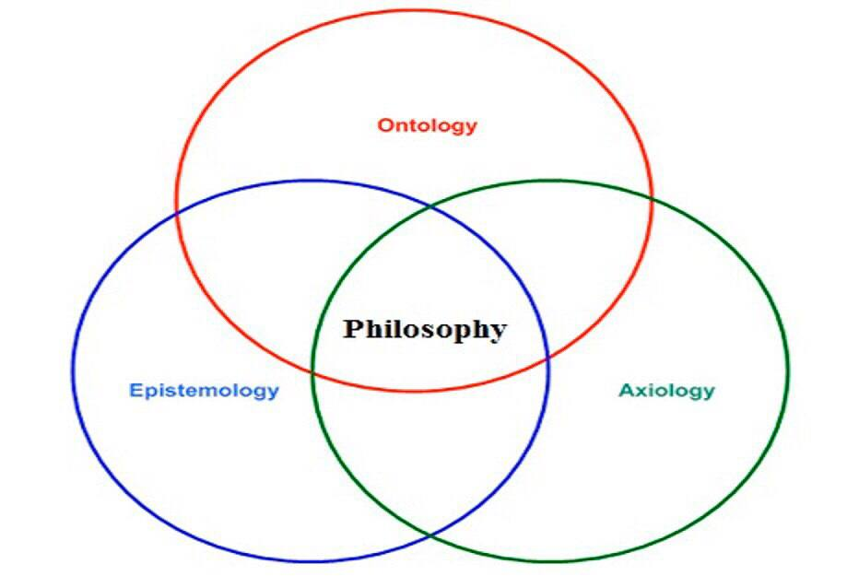
Research Philosophy/
Paradigm
Post-positivism Paradigm
Assumptions
Ontological (Reality) | Single Reality, (to find a solution, to determine relationship )
Epistemological (Researcher’s role) | Distant view & Independent (no relationship between researcher and subject )
Axiological (Value & Judgement) | Value free

Slide 8
Research Method
Guided by the post-positivism this study adopted a quantitative research approach. And it employs a quantitative survey method to reach the stated objectives.

Slide 9
Why
Survey Method
Surveys are an excellent vehicle to measure wide variety of unobservable data, such as people’s preferences, perceptions (competencies & skills), traits, attitudes, beliefs, behaviors, or factual information,
Best-suited for remotely collecting data about a population that is too large to observe directly
To collect information from many individuals, hoping to understand them as a whole.

Slide 10
FIL Definition and Methods Choice (relevancy)
As per the operational definition of FIL, the researcher conceptualize FIL as competency or skill.
Best-suited to measure the participant’s own perception of FIL competency or skills.
To test the relationship between independent (personnel, behavioral and environmental)and dependent (FIL) variables.

Slide 11
Relationship to the Research Participants
Survey method is useful in measuring participants perception
Quantitative studies are not designed to consider participants as partner of analysis.
Therefore present study will not seek feedback from the respondents.
And researcher will report objectivity in findings.

Slide 12
Population
Population
Undergraduate and postgraduate students enrolled in the social science discipline, at the top ten (HEC-ranked) general universities (public/ private) of Lahore city,
Purposive Sampling
Selected universities will be divided in 10 strata as per their ranking and sample will be selected in accordance with equal size sampling technique.
50 participants will be selected from each stratum (university) using purposeful or purposive sampling technique.

Slide 13
Data Collection & Analysis
Questionnaire Development
  Based on existing related literature
  Information Literacy Framework Seven Pillar SCOUNAL Model
  RUSA Best FL Guidelines and Best Practices
Validity & Reliability
Self-administered/online survey questionnaires
Data analysis through SPSS-22 and AMOS to test the model and hypotheses.

Slide 14
Thank You!

