Slide 1

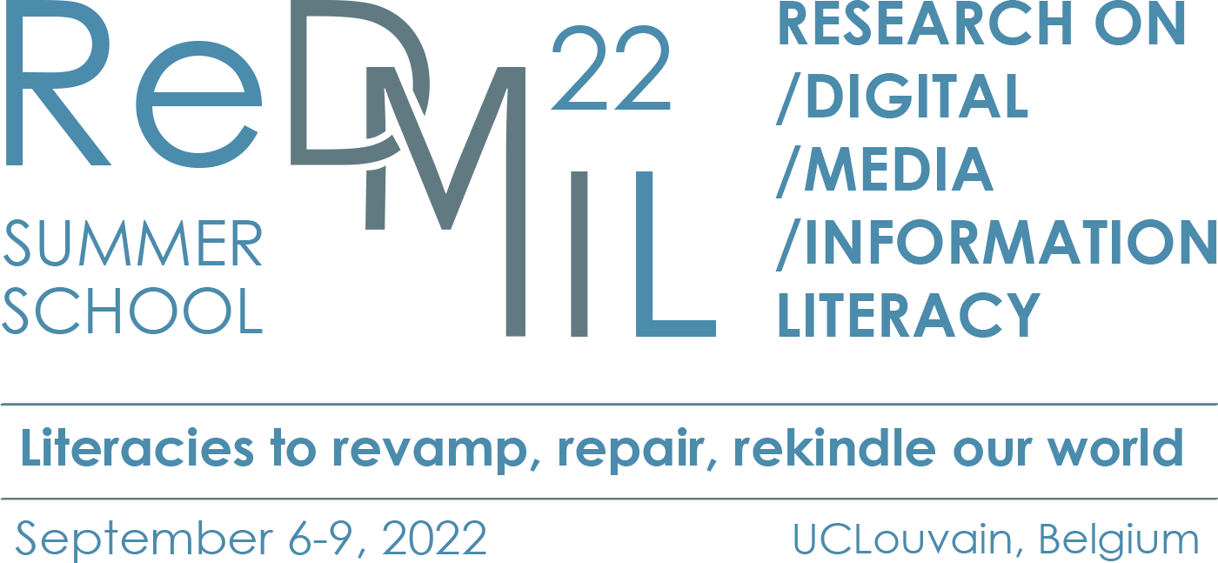


Welcome !
in partnership with

Slide 2
Opening remarks
in partnership with
Pierre Fastrez, UCLouvain
Notes:
Opening remarks – Pierre Fastrez
My name is Pierre Fastrez, I am the co-chair of ReDMIL, and it is my pleasure to welcome all of you on behalf of the organizing committee to this third edition of our doctoral summer school.
We started this summer school series in 2016 with the intent of organizing a scientific event that would put its focus on young researchers in media literacy, information literacy, digital literacy and all other new types of literacies. The event would be part conference, part workshop, and dedicate most of its time to letting these young researchers present and discuss their work with their peers and with academics and more experienced researchers. It would be intentionally a small-scale event, so as to foster exchanges between all the participants. It would also contribute to make the scientific communities that drive research on media, information and digital literacy converge and pursue a fruitful dialogue, by bringing together the younger generations of these communities. This intention is still intact today, and we hope that this year's edition will fully accomplish it.
This year's program includes five keynote lectures by distinguished professors in media, information or digital literacy. Let me welcome them and introduce them to you very briefly:
- Pr. Manisha Pathak-Shelat, Professor of Communication & Digital Platforms and Strategies at MICA, in Ahmedabad, India
- Pr. Shin Mizokoshi, Professor of media studies at Kansai University in Osaka, Japan
- Pr. Anne Lehmans, Professor in information and communication sciences at the University of Bordeaux, France
- Pr Donna Alvermann, Professor of Language and Literacy Education at the University of Georgia in Atlanta, USA, who will be joining us through videoconference. Donna was not able to attend the summer school for reasons beyond her control, and ours, but she will give her keynote and act as a discussant, just as all of our invited speakers.
- Jerry Jacques and I, both from the University of Louvain, will also be giving a lecture
Each keynote presentation will be an important contribution to the summer school in its own right, but it will also frame subsequent workshop sessions where the work of participating PhD students will be presented and subjected to in-depth discussions. These workshops will alternate between a focus on theory and axiological positions in new literacies research, and a focus on methods and epistemology. For these presentations, all of you –all of us, really, keynote speakers and PhD students alike—received the same recommendations: to show their own research as it is made. Instead of presentations of polished results, we asked you to bring your toolboxes, your positions, what you have learned from experience and what you have struggled with, the challenges you face in your research and how they can be overcome.
For all the participating PhD students whose work will be center stage for the next three days, I want to insist on one thing: we come in peace. I know the experience of having to present your work three times, in a poster and two presentations, may be overwhelming, or a source of stress. Presenting your work is a way to expose yourself to criticism, and we understand this all too well. Please bear in mind that the organizing committee, our invited speakers and the discussants who will moderate the sessions are all here at your service, and what we intend to do with you is to have the most productive discussions possible, and to help you thrive in your research.
This year's theme or the summer school is "literacies to revamp, repair and rekindle our world". It stems from the impression we shared, as a research group, that the postmodernity of our contemporary societies comes with many aches and wounds.
The effects of the Anthropocene on our climate, our geography, and the living conditions of all peoples across the world are more visible each year. Post-colonialism exposes relationships of exploitation and domination between people of different origins or belonging to different communities. The post-truth era in which we live challenges our relationship to information and factual knowledge. And as a post-pandemic future is finally on the horizon, we are left asking ourselves how to build, or rebuild the world after.
Media and digital technology are connected to all of these contemporary stakes. Technology has wide-ranging environmental implications. The relations of domination between peoples and social groups of all types take shape through their mediatization. Truth and knowledge are by definition a matter of information. In a context where media and digital technology's foothold in our everyday lives is more important then ever, it seems the health of our societies depends as much on the way populations interact with media and information as it does on the state of medecine.
So instead of seeing new literacies from the perspective of what they support (active citizenship, lifelong learning, critical thinking, social participation...), or from the perspective of what they fight against (the harmful effects of media violence, disinformation, cyberbullying, radicalization, etc.), we ask you to look at new literacies from the perspective of what they contribute to repair in this anthropocenic, post-colonial, post-truth, post-pandemic world: how they are part of the process of reconstructing common ground in a polarized society, and how they support the pursuit of a common good, for example by fostering mutual understanding, intercultural dialogue, or collective knowledge building?
These questions have an inevitable axiological dimension: they speak to the values that new literacies are associated with, and that media literacy education, information literacy education, or digital literacy education stand for. One may think that researchers can consider these issues as external observers of the social phenomena under their scrutiny. We care to disagree, as we consider that research cannot be thought of as disconnected from the social contexts in which it is practiced. Hence our invitation to everyone participating in this summer school to carefully think about the ethical choices and axiological assumptions underlying our research projects. From theoretical choices to their operationalization in methods, to the interpretation and valorization of their results, what are we contributing to? What are the values and ethics associated with new literacies, and how does our research relate to them, support them, document them or question them? What role does research play in the development of new literacies we are all studying?
I invite you to bear these questions in mind as you speak and listen over the course of the next three days. We will come back to them at the end of the summer school.
But for now, I wish you a very productive summer school. I wish all of you to learn and to teach. I also hope you will have fun, and meet people with whom you will make long-lasting contacts, because at the end of the day, if you are not having fun with people whose company you enjoy, why even try? I thank you for your attention, and I now give the floor to my dear colleague Jerry Jacques.

Slide 3
Opening remarks
in partnership with
Jerry Jacques, UCLouvain
Notes:
Thank you Pierre.
I just want to welcome everyone and I hope that you all had a safe a pleasant trip to Louvain-La-Neuve. I will be very brief and practical. I just want to share with you some info regarding the poster session and also about tomorrow morning.
But before that I d'like to introduce you to the members of the organizing committee so that you can identify us and come to us if you have any question or problem. As Pierre said, we want you to feel at ease and comfortable during these 3 days, we feel that's part of the ReDMIL identity and also a condition of meaningful and constructive work.
So I'd like to start with
Géraldine Wuyckens, phd student, also be presenting during the summer school;
Monica Baur, phd student, science communication;
Alexandre Brzozowzki, phd student; in the field of media literacy and neuro-science.
Arnaud Claes, finishing his PhD thesis, before traveling in Japan and visit the home university of Prof Mizukoshi during one year,
Last but not least, Thibault Philippette, professor here at UClouvain with a videos games and literacy as mains research interests, among many things.
And of course Pierre and I.
Turning to the poster session, after this introduction we will have more or less 2 hours for this session. The idea is for you to explain your poster to the people coming by and engage, we hope, in insightful discussion. But do no feel tied down to your poster, you can also of course explore and discover other participants' posters.
At the end of the session we will share drinks together and some snacks. We won't provide dinner tonight but there are many options available in town, feel free to ask us if you need any suggestion, and to make arrangements with other participants.
Regarding tomorrow morning, we will really try to keep the schedule and start at 9AM sharp with the keynote of professor Shin Mizukoshi. The entrance of the building Leclerq is not far from here, it's situated on the place Montesquieu square. We are going to hang signs and send you pictures in WhatsApp group to help you find the place.
So, that's it. Do you have any question at this point ?
Let the poster session begin... !

