Slide 1




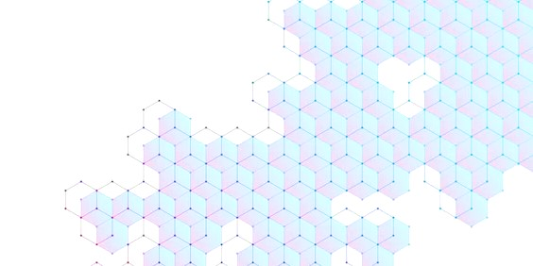
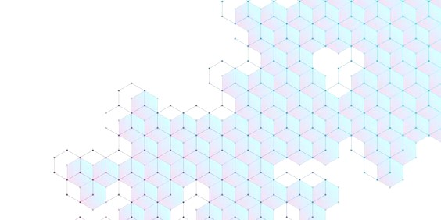


DIGITAL TECHNOLOGIES, OLD AGE AND INEQUALITIES:
TECHNOLOGY APPROPRIATION TRAJECTORIES BY ELDER PEOPLE IN LA PLATA
Guzzo, María del Rosario
National University of La Plata
1) Problem or societal issue that the thesis intends to answer
digital technologies, developed in Argentina since the late 1980s and early 1990s (Benítez Larghi et al, 2014) .
Behind these considerations lies a concern about the extent to which the development of digitalisation processes increasingly embedded in social practices may be redefying social constructions of old age and ageing, i.e. influencing the ways in which the elderly experience age, define themselves and relate to social images of old age (Iuliano, 2019).
Over the last thirty years, digital technologies have been influential in reshaping a wide range of social practices. As part of the debate on whether these processes would contribute to diminishing or deepening social inequalities, the literature has identified a consistently negative correlation between age and levels of digital access and usage. As a result, the elderly have commonly been placed among the most likely to be digitally excluded.
From a socio-anthropological perspective, the present research aims to comprehend elder people’s engagements with digital technologies, approaching them as complex, dynamic and heterogeneous relationships. By examining the biographical trajectories of a group of elder people in the city of La Plata (Buenos Aires, Argentina), it intends to shed light on the various ways in which age-related digital inequalities can be configured.
3) Method
Following the premises of the interpretive paradigm (Guba & Lincoln, 1994), this thesis adopts a qualitative research strategy. Appealing to the biographical method (Bertaux, 1980), semi-structured interviews are conducted.
The unit of analysis is composed by elder people born between the mid- 1930s and the early 1960s and who, during the research, reside in La Plata. Based on criterion sampling and maximum variation sampling (Creswell, 2013), case selection also meets the criteria of gender, educational level and household composition. While following a theoretical saturation criterion (Glaser & Strauss, 1967), it is expected to interview between fifteen and twenty people.
The analysis takes an inductive approach and combines principles from grounded theory, social phenomenology and intersectionality.
2) Research question and theoretical framework of the thesis
The main question this thesis aims to examine is how digital inequalities are configured within the trajectories of digital technologies appropriation by elder people from the city of La Plata (Buenos Aires, Argentina) at present.
While the term “digital technologies” broadly refers to those technologies capable of storing, processing, reproducing, transmitting, and/or converting digital information (Zukerfeld, 2015), the thesis focuses primarily on the Internet, mobile phones and computers (desktop and laptop).
Technology appropriation (Wincour, 2009) is the symbolic and material process through which technologies become embedded in social practices. It encompasses the intertwining of objective factors (related to material access conditions to infrastructure, connectivity and devices), subjective factors (related to digital literacies and usage patterns) and intersubjectively constructed social representations of technological devices. At the same time, in order to situate technology appropriation in a broader social context, it is argued that different types of enduring social inequalities impact on the way people access, use and engage with technologies, comprising digital inequalities (DiMaggio et al, 2003).
Analysing these phenomena in terms of trajectories implies that people’s engagements with technologies (and the resulting digital inequalities) are shaped throughout their personal life-courses. This research specifically targets ‘elder people’ born between the mid- 1930s and the early 1960s, making it possible to address an age group whose birth and primary socialisation predates the emergence of digital technologies. Therefore, reconstructing their trajectories of technology appropriation entails apprehending, from their perspectives, the entire process of emergence and massification of
4) Expected results
From an academic perspective:
To produce empirical data on an under-researched field, as research on age-related digital inequalities has tend to focus on younger age groups.
To problematise the digital divide framework (Norris, 2001) and several notions coined within it to conceptualise age-related digital inequalities, such as the ‘grey digital divide’ (Millward, 2003) and the pair ‘digital natives’ and ‘digital immigrants’ (Prensky, 2001). These notions –which remain influential both within academia an social and political spheres- assume age as an a priori condition for digital exclusion. Thereby, it is argued that they tend to foreclose the analysis of how and why the elderly use and do not use digital technologies.
From a societal perspective:
The findings of this thesis might contribute to public policy-making targeting the elderly’s digital exclusion as, despite the increase of public initiatives in Argentina aimed at promoting digital access and digital literacy among the elderly (Cardozo et al, 2017), they remain to be registered among the most likely to be digitally excluded (INDEC, 2021).

