Slide 1

Journalist’s role in MIL
Redmil 22 - Parallels workshops 5 :
Qualitative and interpretative research methods
Analysis of professional journalists’ role
in media and information literacy (MIL)
in French-speaking Switzerland

Slide 2
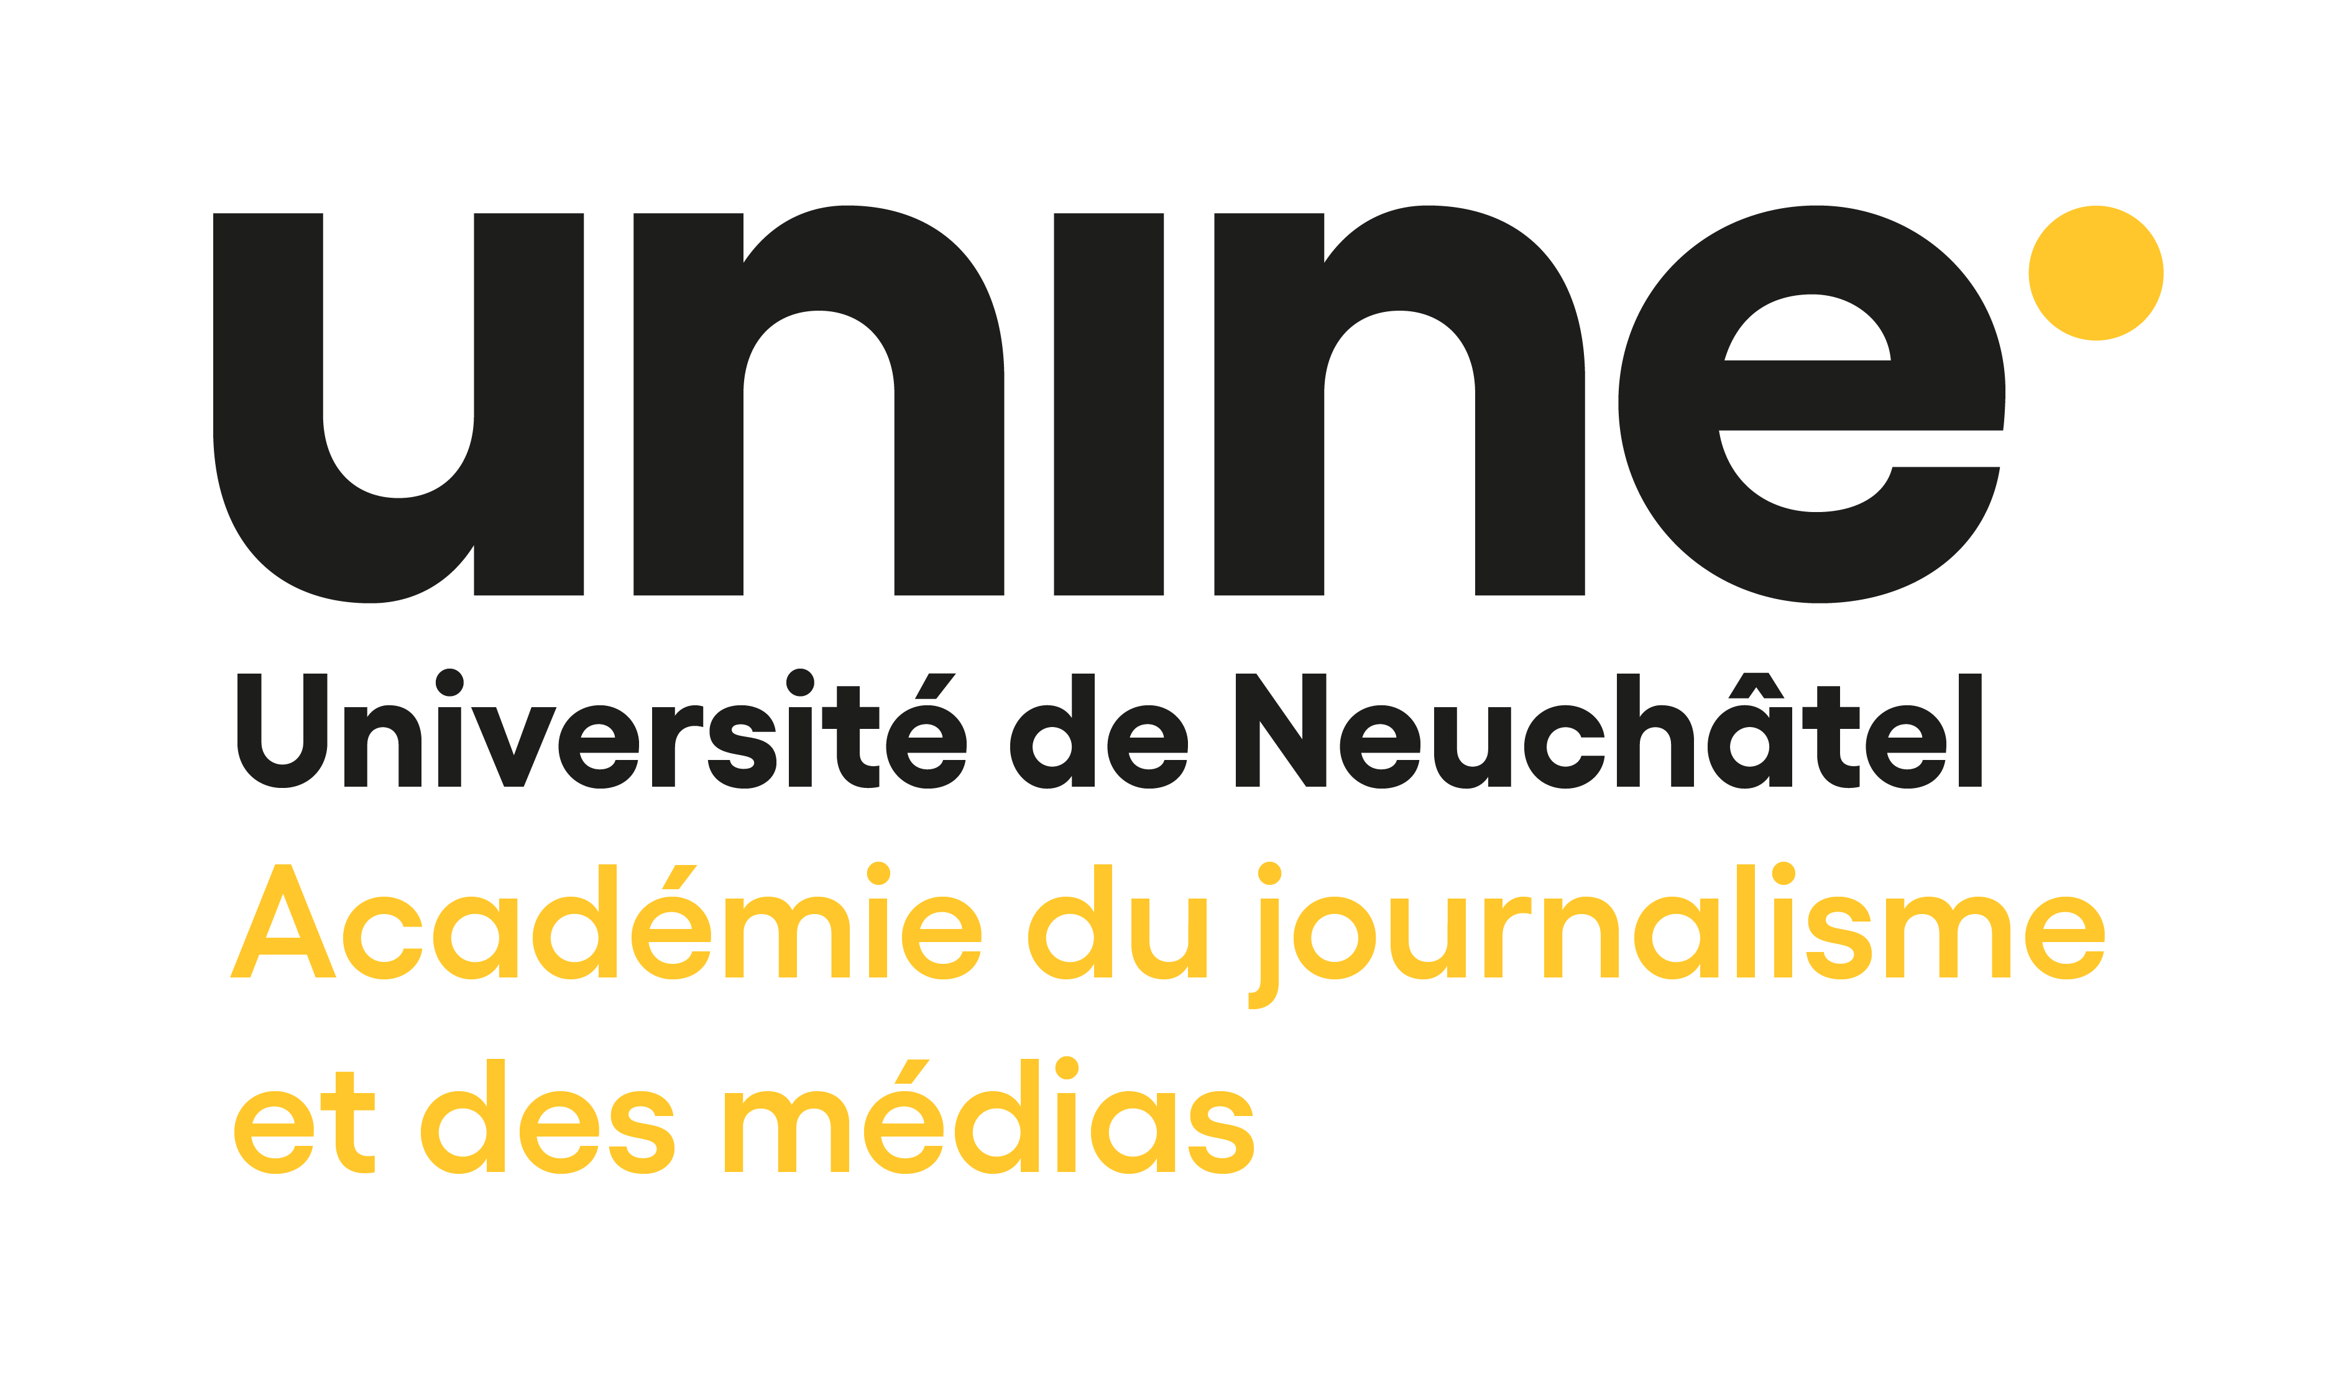
To introduce myself
Julien Perrot, PhD assistant at the Academy of Journalism and Media, University of Neuchâtel (Switzerland).
Within the chair of Digital Journalism, my work is under the supervision of prof. Nathalie Pignard-Cheynel.
I’m a former journalist in written press for 10 years and French teacher for 3 ½ years in France (and its Overseas).
I’ve started this doctoral research 6 months ago, in half-time.
In my university, the PhD lasts 4 years, and i have to depose my thesis project in 1 year.
As it is the norm in Switzerland, my thesis will be composed of 3 or 4 articles published in scientific journals.
I’ve got also a mandate for 1 year, in quarter-time, for Worlds of Journalism Studies.

Slide 3
Research questions
What is the role of journalists when they engage in MIL actions in French-speaking Switzerland ?
What are their motivations, expectations, aims of interventions and pedagogical practices ?
What balance do journalists strike between protecting the most vulnerable audiences and stimulating their digital creativity ?
How do journalists and their partners (teachers, institutions, associations) manage to co-construct MIL devices ?
Is the approach that the journalists want to promote in MIL devices the same as that of their partners ?
What role(s) journalists want to play in MIL devices and that they effectively play ?

Slide 4
Academic context
In the Swiss academic world, very few qualitative studies are concerned with the MIL, either in or out of school. Quantitative approaches on the young public are preferred, such as the Easyvote political monitor of Gfs.bern, the JAMES studies of the Zurich University of Applied Sciences or the publications of the Fög research institute, which all have a rather depreciatory view of youth information practices. They indeed highlight a fragmentation of information practices and even a weakening of them.
Indeed, for these institutions, this public, by privileging "on-demand" information channels from platforms or digital social networks (DSN) providing constantly searchable information and directly responding to individual preferences (the most popular being Youtube, Instagram, Tik Tok, Twitter, Facebook, Snapchat, Google, Netflix and Wikipedia), would turn away from information in the noble sense of the term, that is to say verified and produced by professional journalists (Jael Bernath et al., 2020).

Slide 5
Academic context
Suggested by algorithms, the information consumed by young people would thus be more and more segmented and atomized, less generalized and more focused on their interests, their expectations and the virtual communities to which they belong. Forsaking traditional media, young people would rather turn to pure players favoring short video formats such as Buzzfeed, Brut or Konbini, or information portals such as Watson.
In this context of supposed mistrust and growing disaffection with traditional media (gfs.bern, 2017), MIL is now taking on greater importance in the training of citizenship, at school but also and above all outside the school setting, where young people but also adults diffuse and produce their own information on the DSN. Indeed, as the international texts promoted by the Unesco for the last twenty years underline, MIL does not only concern young people but has to be a lifelong training for all individuals.

Slide 6
Research methods
Following a qualitative and "transliterative" approach combining media, information and digital literacies with the 7C (comprehension, criticism, creativity, citizenship, conflict, consumption, communication) competences of MIL (Divina Frau-Meigs, 2019), our research will be based on :
1) the in situ observation of various educational experiences with the participation of professional journalists, i.e. of MIL on, in and via journalism (Maarit Jaakola’s, 2020) :
in school lessons, the school media week (organized at the end of November by the Intercantonal Conference on Public Education for French- speaking Switzerland and Ticino - CIIP), the visits of students to media offices or the uses of youth media programmes on this issue, especially those produced by the public channel RTS Discover,
but also towards adults with thematic workshops organized by the association of French-speaking listeners and viewers (RTSR), and training actions towards teachers, librarians or social workers, particularly in the pedagogical colleges (HEP-Bejune – cantons of Jura, Neuchâtel and Bernese Jura, HEP-FR – Fribourg, HEP-VS – Valais, HEP Vaud, and IUFE – University institute of teacher education of Geneva).

Slide 7
Research methods
2) semi-structured interviews conducted mainly with journalists, but also with their institutional or associative partners.
To analyze the interviews with the journalists, we will draw on the model developed by Thomas Hanitzsch and Tim Vos (2017), who consider journalists' roles as consisting of a renegotiating discourse in which actors struggle to preserve or transform journalistic identity along four overlapping dimensions.
Journalists’ roles may be studied with regard to :
1) normative ideas (what journalists should do),
2) cognitive orientations (what they want to do),
3) professional practice (what they really do),
4) narrated performance (what they say they do).

Slide 8
Research methods
As journalism is a socio-discursive practice, the researcher has to make a constant effort to situate himself at the level of unveiling the conditions of production of the journalists' discourse, its content, its effects and its intentions (Jean Charron & Loïc Jacob, 1999).
So the interview as a method necessarily entails a “re-staging” of how the data came about, the relationships that were formed, the stages and the places given to the materials collected (Maryvonne Charmillot & Caroline Dayer, 2007).
The interaction situation during the interview can indeed be a playground for activating or reactivating interaction modalities of domination (depending on the gender, age, trajectory of the actors, the media or the university for which they work) : the researcher can then analyze ideological determinants and the journalist can stage common attitudes to his professional field (Nadège Brousteau et al., 2012).

Slide 9
Research methods
The interview with the journalists is a game of mirror exchanges with subjects who are themselves frequently asked to conduct interviews with their sources and who find themselves in an inverted position compared to their traditional interactions. The challenge would be thus for both the researcher and the journalist to increase their reflective judgement on their professional practice (Nadège Brousteau et al., 2012).
The interview should then be seen in relational terms : the researcher has to analyse how the respondents understand the request, interpret the survey situation and invest a place in the enunciation, and what discursive registers they actualize in the interaction with the researcher, who thus must adopt pragmatic postures related to the interpretive and counter-interpretive activities conducted by the respondents, and not only empathy or neutrality (Didier Demazières, 2012).

Slide 10
Discussion of methodological choices
Exploratory interviews with some experts in MIL in French-speaking Switzerland should enable me to better identify the different actors and media involved in this issue, as a prerequisite for initial contacts for the semi-directive interviews, in which the grids are still to be developed.
In situ observation would allow me to better understand the reality of the challenges of MIL in French-speaking Switzerland. Even if there is an attempt at harmonization with the Romand study plan (PER) of the CIIP which lists a series of competences to be developed in digital and media literacy, the federal institutional context creates a great variety of situations depending on the cantons, corresponding to the three models of implementation : curricular transversality, unique programs or practical activities (Mariska Kleemans & Gonnie Eggink, 2016). So I don't know yet if I'll make a comparison between the different educational systems or choose one in particular.

Slide 11
Discussion of methodological choices
At last, the audiences targeted by the MIL devices I will study could be interviewed in focus groups, in order to try to measure the knowledge and/or skills acquired as a result of these educational actions. As Anne suggested to me, I think this method would be more efficient with young people, because it’s a bit hard to have developed answers from them in a interview with open questions.
In order to articulate the three empirical approaches and make them complementary, I will seek to interview, as a priority, the people participating in the devices I will have observed.
In order to elaborate the observation grid to collect data before the interviews, I could try to establish categories according to the subjects addressed and the objectives aimed at by both the journalists and teachers, and confront the underlying approaches they envisaged.

Slide 12
Epistemological position
As a former journalist, I am aware of the risk of sharing the normative approach which consist in changing learners' perceptions of traditional media in order to enhance the role of the news media in evaluation of information and the exercise of democracy.
However, I also agree with my research director's position that the traditional media must reinvent their economic model by starting first of all from the information practices of their audiences, and seeking to adapt contents and formats to them.
As a former French teacher who participated in various MIL devices in secondary schools in France, I am rather inclined to adopt the political approach promoted by Jacques Gonnet and the Clemi, according to which it is by producing media themselves that teenagers become aware of the constraints of the profession and of the civic dimension of the plurality of information sources and opinions. But the Swiss Romand context is different : in the PER, MIL is directly connected to digital literacy, so I think I will rather adopt a “transliterative” approach in my research.

Slide 13
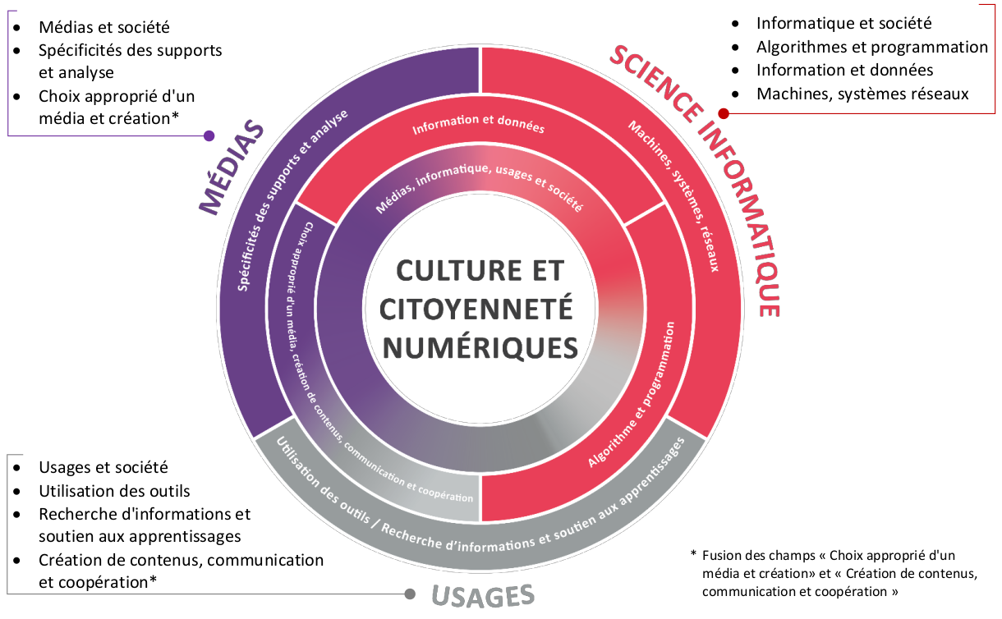
Digital literacy according to the PER

Slide 14
Some questions
Is it better to choose a case study or to make a comparison between the different education systems in the cantons of French-speaking Switzerland ?
How to maintain a distance from its research object when the researcher has already been an actor in this object ?
How to identify the stakeholders who will be the most useful in the construction of the research object, when there has been very little qualitative work on that issue ?
How to assess the relevance of the semi-directive interview grids ?
Is the qualitative method more legit when it is based on a large number of observations and interviews ?

Slide 15
References
- Howard Saul Becker, Le travail sociologique : Méthode et substance, Res socialis n°26, Academic Press Fribourg, Fribourg, 2006.
- Jael Bernath, Lilian Suter, Gregor Waller, Céline Külling, Isabel Willemse & Daniel Süss. « JAMES - Jeunes, activités, médias - enquête Suisse », Université des sciences appliquées de Zurich - Département de psychologie appliquée, Zurich, 2020.
- Nadège Broustau, Valérie Jeanne-Perrier, Florence Le Cam & Fabio Henrique Pereira, « L’entretien de recherche avec des journalistes », Sur le journalisme, vol.1, n°1, 2012.
- Nadège Brousteau & Florence Le Cam. 2012. « L’entretien de type qualitatif : Réflexions de Jean Poupart sur cette méthode », Sur le journalisme, vol.1, n°1, 2012.
- Maryvonne Charmillot & Caroline Dayer, « Démarche compréhensive et méthodes qualitatives : clarifications épistémologiques », Recherches qualitatives, hors série n°3, 2007.
- Jean Charron & Loïc Jacob, « Énonciation journalistique et subjectivité : les marqueurs du changement », Les études de communication publique, cahier n°14, Département d’information et de communication de l’Université Laval, Québec, 1999.
- Emmanuelle Daviet, Interclass’ : éducation aux médias et à la citoyenneté, ESF sciences humaines, coll. Pédagogies, Paris, 2019.
- Didier Demazière, « L’entretien de recherche et ses conditions de réalisation. Variété des sujets enquêtés et des objets de l’enquête », Sur le journalisme, vol.1, n°1, 2012.
- Isabelle Féroc Dumez, Marlène Loicq & Aude Seurrat, « Dossier en débats : questionner les relations des chercheurs aux acteurs et aux pratiques de l’Éducation aux médias et à l’Information (EMI) », Communication & langages, vol.201, n°3, 2019.
- gfs.bern, « Moniteur politique easyvote 2017 : Baisse d’intérêt pour l’information et recul de la confiance témoignée - Les jeunes adultes et la politique à l’ère des Fake-News et du paysage médiatique en mutation », Fédération suisse des Parlements des jeunes, Berne, 2018.
- Thomas, Hanitzsch & Tim P. Vos, « Journalistic Roles and the Struggle Over Institutional Identity: The Discursive Constitution of Journalism », Communication Theory, vol.27, n°2, 2017.
- Manuel Hermann, Cédric Stortz & Célestine Perissinotto, « Utilisation problématique d’Internet en Suisse : Conclusions et recommandations du groupe d’experts “Cyberaddiction” - Rapport de synthèse 2018-2020 », Groupement romand d’études des addictions, Zurich/Lausanne, 2020.
- Martin Hermida, « EU Kids Online Suisse 2019 - Les enfants et les jeunes suisses sur Internet : risques et opportunités. Extraits des résultats », Haute école pédagogique de Schwyz, Goldau, 2019.
- Maarit Jaakkola, « Journalists as Media Educators: Journalistic Media Education as Inclusive Boundary Work ». Journalism Practice, november 2020.
- Amandine Kervella, Céline Matuszak & Béatrice Micheau, « La place du journaliste dans l’éducation aux médias : témoin, expert ou éducateur ? Regard sur le nouveau dispositif de résidence-mission de journaliste », Les Cahiers de la SFSIC, nº 14, 2017.
- Mariska Kleemans & Gonnie Eggink, « Understanding news: The impact of media literacy education on teenagers’ news literacy », Journalism Education, vol.5, n°1, 2016.
- Kate Morris & Frances Yeoman, « Teaching Future Journalists the News: The Role of Journalism Educators in the News Literacy Movement », Journalism Practice, october 2021.
- Iryna Negreyeva & Revati Prasad, « Developing Media Literacy by Teaching Citizens the Standards of Professional Journalism », Journal of Applied Journalism & Media Studies, vol.1, n°1, march 2012.
- Nicolas Pélissier, « La plume dans la toile : l’identité des journalistes à l’épreuve des réseaux numériques », MédiaMorphoses, nº 4, 2002.
- Laurent Petit, Melina Solari Landa, Nathalie Walczak & Mathieu Bégin, « Chercheurs et acteurs de l’EMI : tous dans le même bateau ? », Communication & langages, vol.201, n°3, 2019.
- France Renucci, « Enseignants, journalistes : droits et devoirs », Médium, vol.5, n°4, 2005.
- Pia Schoch, Gregor Waller, Paulina Domdey & Daniel Süss. « ADELE - Activités, Digitales, Education, Loisirs, Enfants - Les médias numériques au sein des familles avec enfants âgés de 4 à 7 ans », Haute école des sciences appliquées de Zurich - Département de psychologie appliquée, Zurich, 2018.
- Jean-François Tétu, « Du “public journalism” au “journalisme citoyen” », Questions de communication, nº 13, juillet 2008.

