Slide 1
In Silico: Design, use and meaning of an educational app
Gavin Duffy

Slide 2
Societal Problem Addressed
Research problem: lack of understanding around ‘meanings’ attributed to educational apps; thus, disunified meanings of educational apps between actors.
Research aim: chart the development and changing of an educational app’s meaning throughout its lifecycle; seeking a means to create unity (or coherency) in the meaning given to apps by different actors.

Slide 3
Research questions
i. How does each actor within the circuit of the app interpret and use the apps in my study?
ii. How do the apps in my study shape and get shaped by the everyday routines and habits of schooling?
iii. What role do the apps in my study play in how schooling is administered and how learning is understood?

Slide 4
Conceptual framework and theoretical foundations

Slide 5
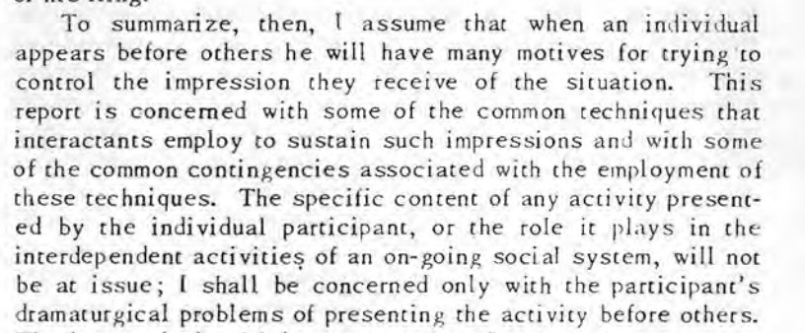
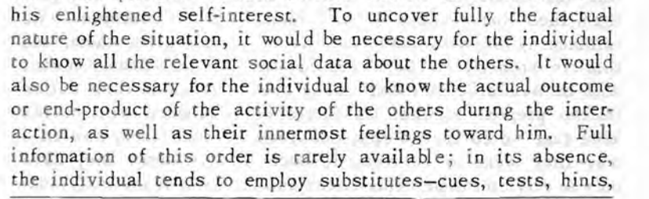
Presentation of self in everyday app use
Presentation of self in the interactions around app use, e.g. development team to customers; teachers to students, etc.
However, it can also be seen in app use itself: just as personal identities exist in a relationship of mutual recognition, so too does the relationship between the app and the user.
We should therefore expect dramaturgical problems and definitional disruptions between people but also between people and apps.
Goffman (1959, 8)
Goffman (1959, 160)

Slide 6
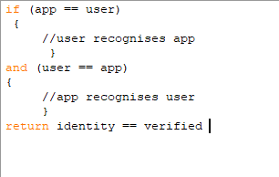
Creating the social: apps as text and users as audience
Contemporary technology use has been framed as an audience-text relationship within audience studies and reception theory drawing on Hall (2003) e.g. Dahlin (2018); Das (2017); Livingstone (2013).
I will frame this relationship as mutually reciprocal using ANT (Latour, 2007) and positioning apps as andere Lebeswesen (Müller, 2015).

Slide 7
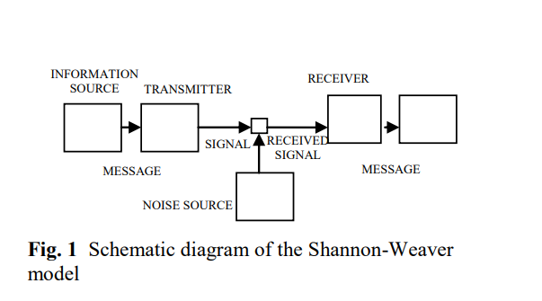
How have audiences been understood?
Example of the Shannon-Weaver model of communication (Al-Fedaghi, S., 2012)

Slide 8
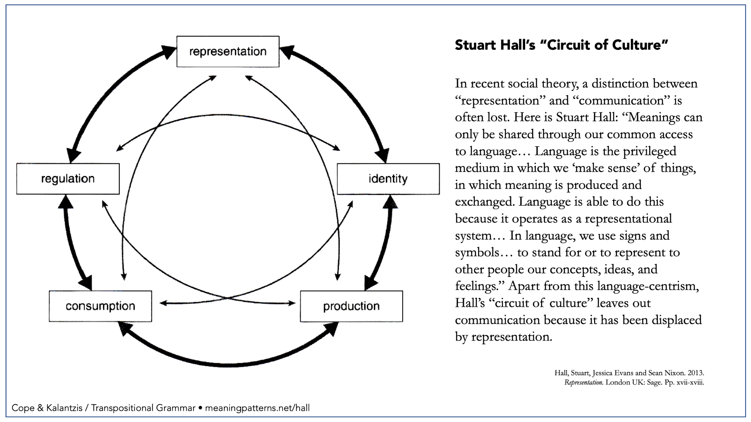
How can we understand audiences differently?
A description of du Gay, P., Hall, S., Janes, L., Mackay, H. and Negus, K.’s (1997) circuit of culture model for meaning making

Slide 9
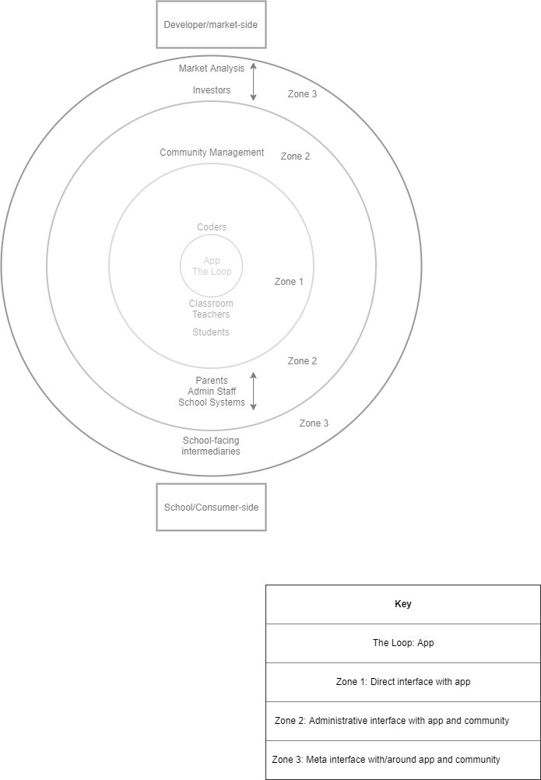
How can we understand an app and its actors?
Using Park and Burgess’ (1967) concentric zone model of a city, I have sketched out the relations actors have to an app and to each other.
This is an ecological, cell-based model, allowing for a porous structure and inter-zone movement.

Slide 10
Research axiology and relevance

Slide 11
Digital imaginaries: What should guide new media research?
Recentring the human, both as producers and audiences.
Advocates for a range of knowledges, across profession and age ranges. Focuses on the voice of on-the-ground staff and young people.
Conscious consideration of participants as knowledge holders and research as a reciprocal process.

Slide 12
Who is this research for?

Slide 13
Schools and school communities
Principals and purchasing committees
schools have limited resources; technological churn has an economic toll.
Teaching and admin staff
staff are universally time poor; many feel their work is not seen or understood by others; technological churn is poor for morale.
Students
young people are inundated with technology and the myth of the ‘digital native’ persists; thus, few people actually ask students about their technological experiences.

Slide 14
App development companies
Public facing benefit:
Many companies posit a legitimate desire to help schools, largely through reducing ‘busy work’. Without data on the issues real users are having, this desire remains only as a desire.
Internal company benefit:
Companies appear disunified in their own understandings of their product. Without data on these contentions, many staff feel unheard or misunderstood.

Slide 15
Expected findings

Slide 16
Case 1 - English language app
App one:
Small, for-profit company
Queensland based
‘Educator focused’
In-class ‘learning’ app
Highly stylised/strong art direction
Personalised experience
Target audience: K-12
Participants | Number
Developers | 7
School staff | 5
Students | 10
Parents | 0
Total | 22

Slide 17
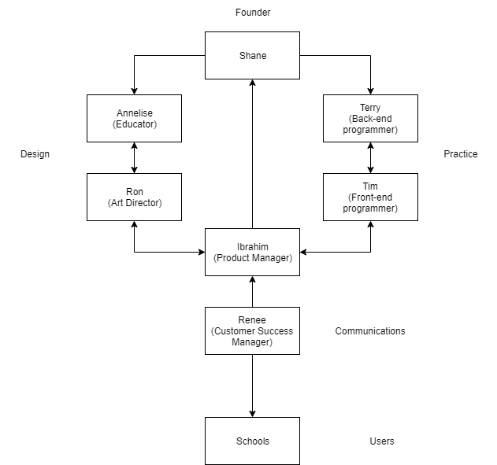
Mapping the company

Slide 18
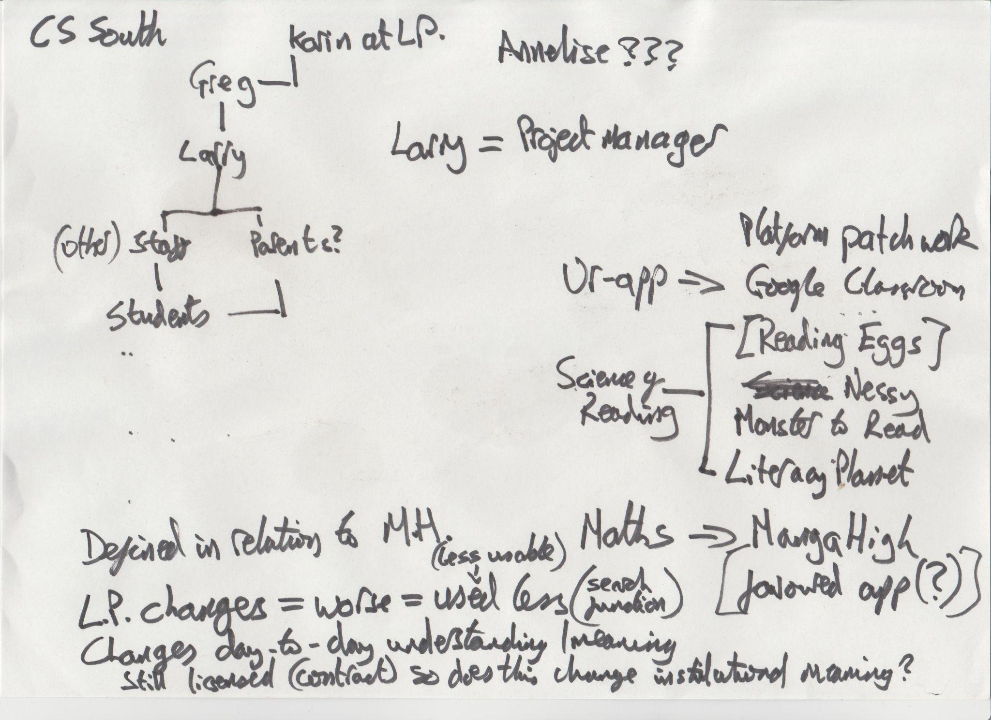
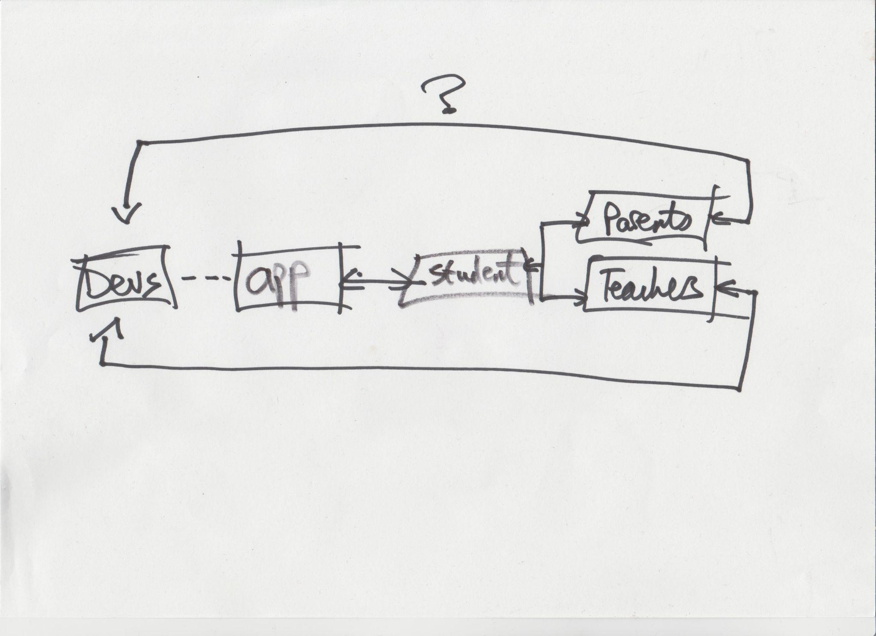
Mapping the school
Data for case 1 comes primarily from one, small primary school in Melbourne. Thus, I have been able to ‘map’ how the app trickles down/spirals out within a singular school.

Slide 19
Shared signs or dramaturgical failures?
Company data:
As seen in the company map, there is a top-down, founder-driven vision for the company. This aesthetically-grounded vision drives the rest of the company.
The app has recently moved from Flash to HTML; described by one coder as biting off more than they could chew but staff were adamant that the app functioned fine.
Most staff frame the company as ‘educator-focused’ (including having educators on staff). Community management discuss ranking customers based on income and coders complain of marketing winning out over all else. This discord was supposedly bridged by company’s Product Manager/‘dev wrangler’.
School data:
Top-down approach taken in the participant school: principal believes in the ‘science’ of the app but leaves it to the teachers to use it. Teachers used the app in a perfunctory manner; students did not care about art design.
Teachers appeared frustrated by the changes to the app; quick to point out that the app does not function fine. Core ‘search’ function has been removed.
School staff did not feel a connection to the company at all. No in-person PD sessions, while another, similar app ran one session in the school, creating a lot of good-will with staff.
Students were ambivalent overall but found the app difficult to use. Students also worried that their performance now will follow them into the future (including university admission).

Slide 20
Key company example: data sharing
CEO:
‘Do other companies that you're partnered with, do you have data sharing programs with or anything like that?
No. We don't share data.’
Customer success manager:
‘Here in Australia and New Zealand, we're a lot more relaxed around, you know, what we can and we can't do. So for instance, you know, a school will email us a spreadsheet of all of their student names and classes and things like that… In Europe, you're not allowed to share that information or send that information between organizations…Here we just email it backwards and forwards.’

Slide 21
Key school example: data use
Principal:
‘We're trying to use programs and teaching that are aligned with best practice and evidence. So that was, yeah, that was the reason for the switch over. Everything that we're using currently is backed by science and research and evidence. So we follow the science of reading and science of teaching.’
Classroom teachers:
‘Yeah, everything else is missing. I can't access anything… Can you see what I've got? I don't have access to anything. The classroom, setting of assignments, it's this mission area… There's no classroom. I can't assign any books or. I can’t get into spelling’.

Slide 22
Case 2 - administrative app
App two:
Small, for-profit company
Melbourne based
‘Administrator and parent focused’
O2M and M2M communication and permission slip app
Uniform experience
Target audience: K-12 schools (primarily Catholic and Independent)
Participants | Number
Developers | 7
School staff | 4
Students | 0
Parents | 0
Total | 11

Slide 23
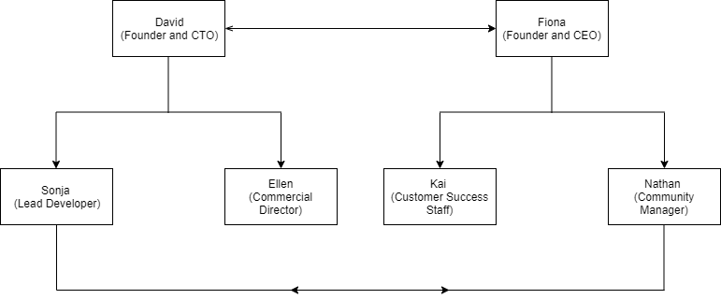
Mapping the company

Slide 24
Mapping the school?
Getting a singular school as a case-object has been more difficult for the administrative app; this still poses a challenge for the research in its current state.

Slide 25
Shared signs or dramaturgical failures?
Company data:
Immediately clear split within the company: one side was distinctly business and coding oriented, while the other was more vision and community management oriented. Possibly gendered/driven by two co-founders(?).
Appeared to rely heavily on a small number of core staff members. In particular, the community manager was described as a ‘soulmate’ for the company and ‘fucking amazing’. He has since left.
A perceived two spheres within schools: the business and the teaching. These are ‘two different bubbles that have a very, very small overlap’. Teachers ‘prefer to be kept in the dark’ but the business of schooling is becoming increasingly important.
Similar as with the other company, coders felt stability and functionality was under-served, with a preference being given to new ‘shiny’ products.
School data:
Seemingly more positive (and active) relationship between school staff and company, compare with previous app. This is not necessarily driven by geography; one participant is at a school in NSW. Seeming connection to Community Manager and founder; reflects importance of in-person sessions mentioned in previous app case. No real knowledge or concern for overall company vision.
Used in unexpected ways by some e.g. being used by one school to streamline approval processes for teacher PD sessions. Others incorporated the app into their existing framework, one school ‘Barkerised’ the app. Despite aim of making administration uniform; the app itself appears surprisingly malleable, a cypher for the school.
Across multiple schools, the app was described as going down with regularity (but not at consistent times): ‘when it goes down, it goes down hard’. Has become the slowest app used in the school, for some participants. reflective of lead developer’s complaints around platform stability.

Slide 26
Key company example: data security
Commercial director:
‘Business managers and principals within schools, I have found would always be asking us the question, you know, ‘Please tell us, how do you manage your privacy and security of data?’ and if you're not, you know, up to speed then then they're not going to be, you know, interested in your services.’
CTO:
‘In general, I usually know more than [schools] do. Genuinely. Because we put a lot of effort. We have a security consultancy firm on, you know, we pay them monthly. They do penetration and vulnerability testing on us twice a year. We're just in the middle of it now, a cycle of it now. They're also working with us on our ISO 27001 cyber security quality assurance.’

Slide 27
Key school example: data handling
Company community manager:
‘I think a lot people's issue with like privacy and Big Data is not necessarily the data itself. It's who has access to it…But I think schools have a trusted persona, so they trust the data being used for this, that being their students or their child's data… is being used for their education and for their benefit, not to sell something, not to control them, not to whatever…No, it's not used for marketing or anything like that.’
School executive assistant:
‘I feel like now I can constantly watch people because I have the authority to see where everything is…So it’s now like, ‘okay, you know, Big Brother is watching. But in my body,’... So yes, people may feel a little bit threatened that I am on top of it, but it also is a good thing.’

Slide 28
Conceptualising the actors in a circuit, as a circuit

Slide 29
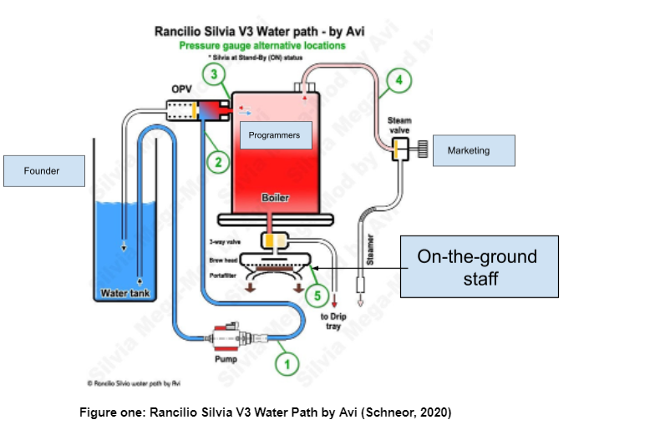
Keystones within the companies

Slide 30
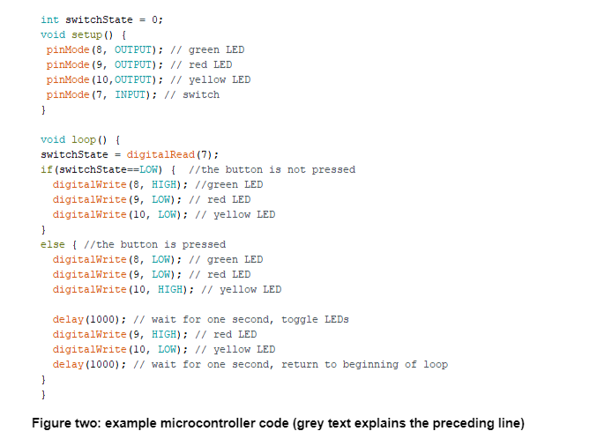
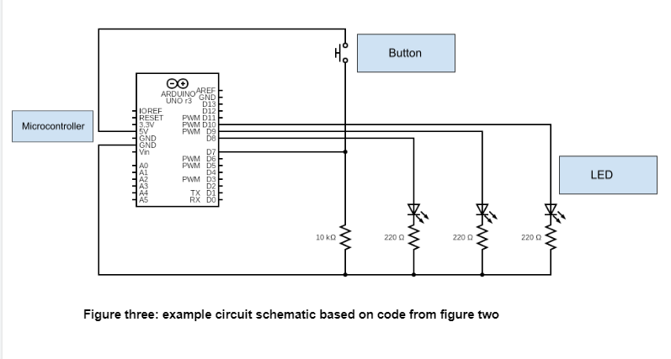
Viewing the companies as circuits

Slide 31
What is the point of it all?
Point one:
Apps act as a contemporary form of communication and network-nexus in schools.
What does my research say about this?
Apps are not objective/neutral; they remain rooted in the interpersonal, hinging on human-human and human-app communication.
Point two:
If apps depend on communication, then we should have a common vocabulary.
What does my research say about this?
Such a shared vocabulary appears to be extremely lacking in practice. This applied to the intra-company circuit, intra-school circuit, and the overall inter-actor circuit.
Samuel Beckett (1931, 47) critiqued language itself claiming, ‘There is no communication because there are no vehicles of communication’. I use educational apps to examine this claim today, asking questions around the limitations of our speech and text-based communication in a digitally networked environment. This is reflected in my own reporting on my data; relying on models and metaphors or circuits to imagine these interpersonal systems.

Slide 32
Reflexive questions around the research
How can participants be best incorporated as co-designers of research?
How can I ensure my research has tangible impact; particularly, how can I best convey abstract ideas (such as data) to a range of audiences in a meaningful manner?
How could my concentric zone model be applied to other, informal education settings?

Slide 33
Bibliography
Al-Fedaghi, S. (2012). A conceptual foundation for the Shannon-Weaver model of communication. International Journal of Soft Computing, 7 (1), 12-19.
Beckett, S. (1931). Proust. Grove Press, NY.
Dahlin, E. (2018). Ontological ordering: Achieving audience in internet practice (Doctoral dissertation, Department of Media Studies, Stockholm University).
Das, R. (2017). Audiences: A decade of transformations–reflections from the CEDAR network on emerging directions in audience analysis. Media, Culture & Society, 39 (8), 1257-1267.
Du Gay, P., Hall, S., Janes, L., Madsen, A. K., Mackay, H., & Negus, K. (1997). Doing cultural studies: The story of the Sony Walkman. Sage, London.
Goffman, E. (1959). The presentation of self in everyday life. Garden City, NY, 259.
Hall, S. (2003). Encoding/decoding (pp. 127-137). Routledge, London.
Latour, B. (2007). Reassembling the social: An introduction to actor-network-theory. Oup, Oxford.
Livingstone, S. (2013). The participation paradigm in audience research. The communication review, 16 (1-2), 21-30.
Müller, M. (2015). Assemblages and actor-networks: Rethinking socio-material power, politics and space. Geography compass, 9 (1), 27-41.
Park, R. E., & Burgess, E. W. (1967). The city (Vol. 239). University of Chicago Press, Chicago.

