Slide 1
In Silico: Design, use and meaning of an educational app
Gavin Duffy

Slide 2
Research method

Slide 3
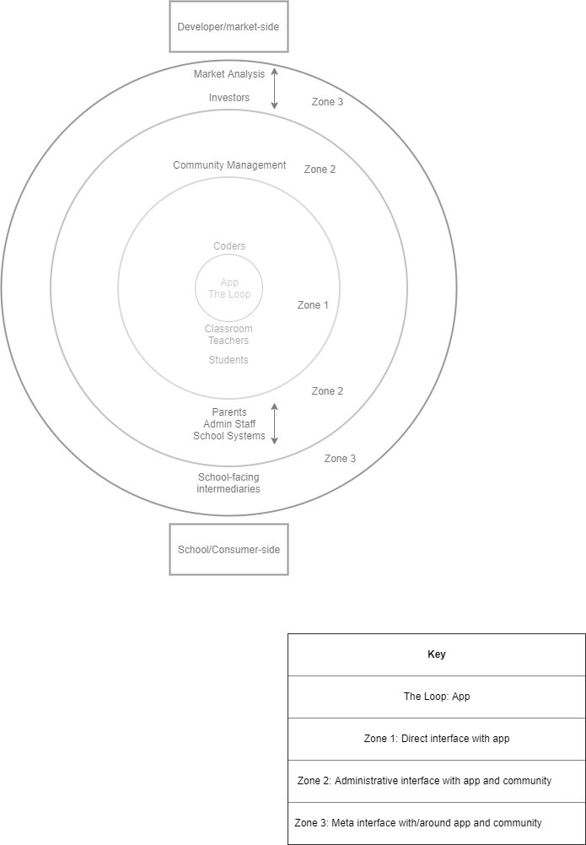
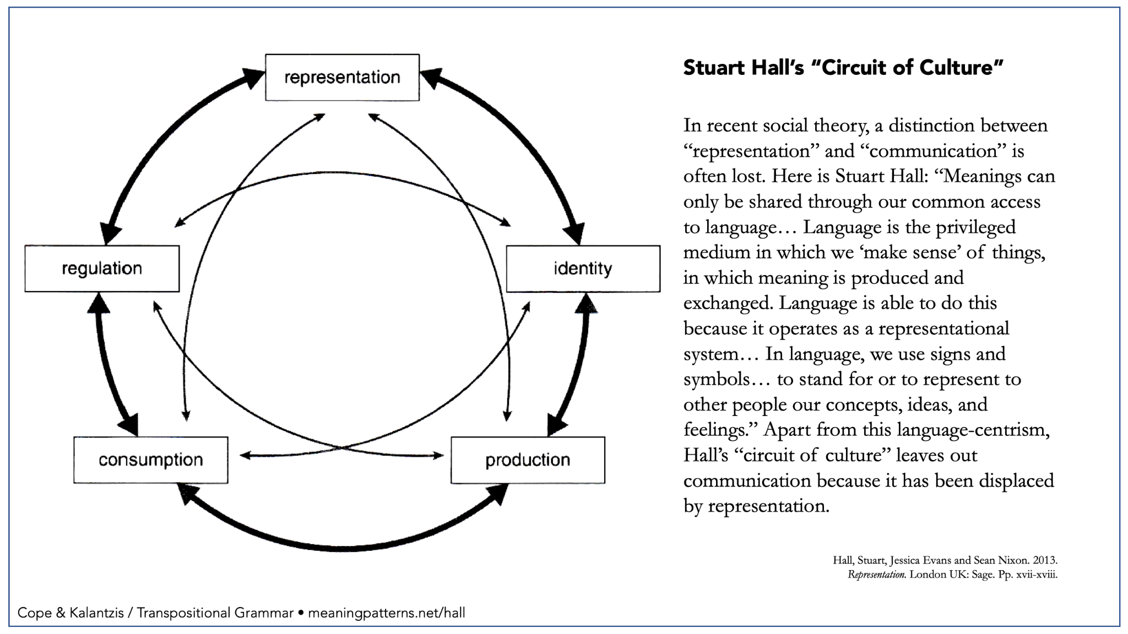
Research background

Slide 4
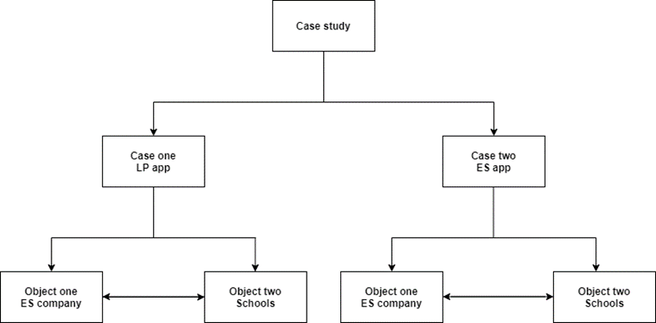
Data collection method
Seeking thick description, drawing on (digital) ethnographic methods e.g. Geertz (2008) and Pink (2016).
Conducted through semi-structured interviews and app walkthroughs (see Light et al, 2018) to build two cases.

Slide 5
Data Collected

Slide 6
Case 1 - English language app
App one:
Small, for-profit company
Queensland based
‘Educator focused’
In-class ‘learning’ app
Highly stylised/strong art direction
Personalised experience
Target audience: K-12
Participants | Number
Developers | 7
School staff | 5
Students | 10
Parents | 0
Total | 22

Slide 7
Case 2 - administrative app
App two:
Small, for-profit company
Melbourne based
‘Administrator and parent focused’
O2M and M2M communication and permission slip app
Uniform experience
Target audience: K-12 schools (primarily Catholic and Independent)
Participants | Number
Developers | 7
School staff | 4
Students | 0
Parents | 0
Total | 11

Slide 8
Data Analysis

Slide 9
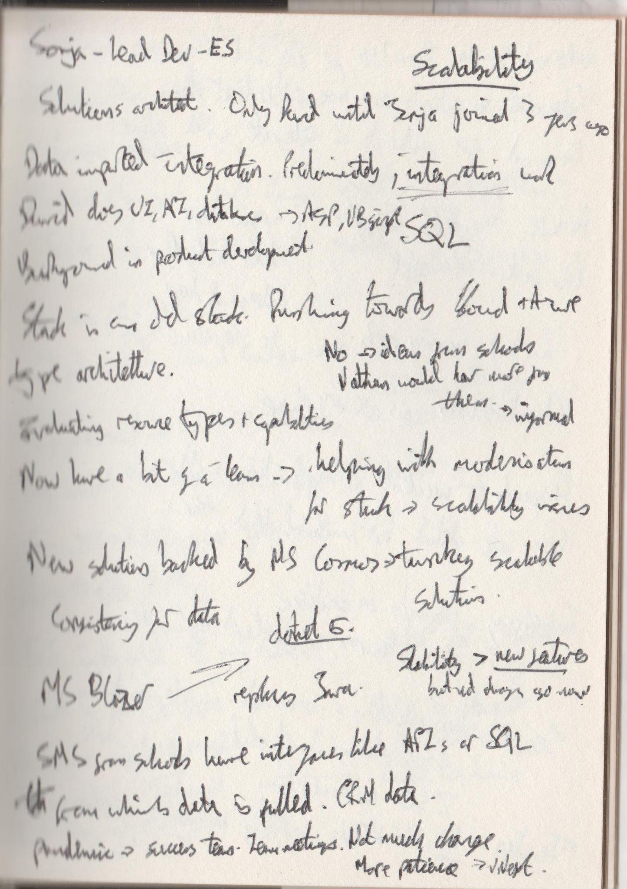
Collecting and cleaning data
Interviews are recorded either via Zoom or with a dictaphone.
In-situ notes are taken to ensure important themes are highlighted and to mark themes for follow up questions.

Slide 10
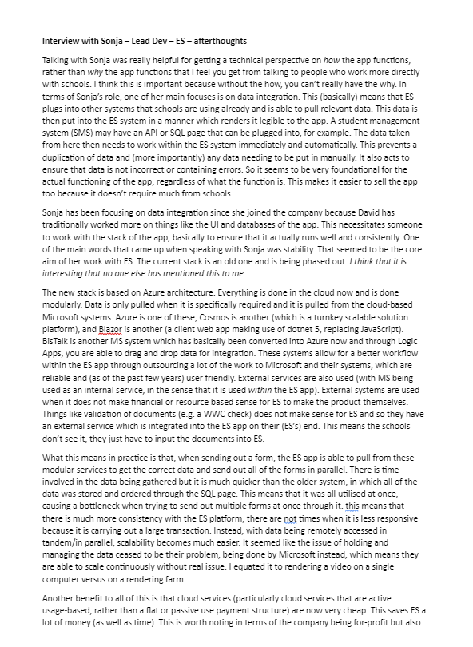
Post-interview notes
In-situ interview notes are transformed into long-form notes, immediately following the interview. This is intended to crystallise my thoughts and draw out the themes gestured towards in the in-situ notes.
These notes go on to form what I look for in the NVivo tagging process, alongside the transcription process.

Slide 11
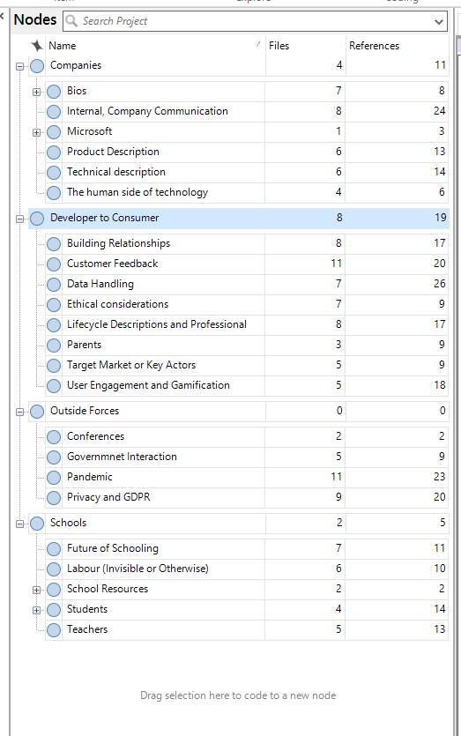
NVivo Tagging
NVivo tags created based on initial areas of interest; themes arising from interview notes; and themes arising from transcripts. All contributes to an abductive data approach (Ong, 2012).

Slide 12
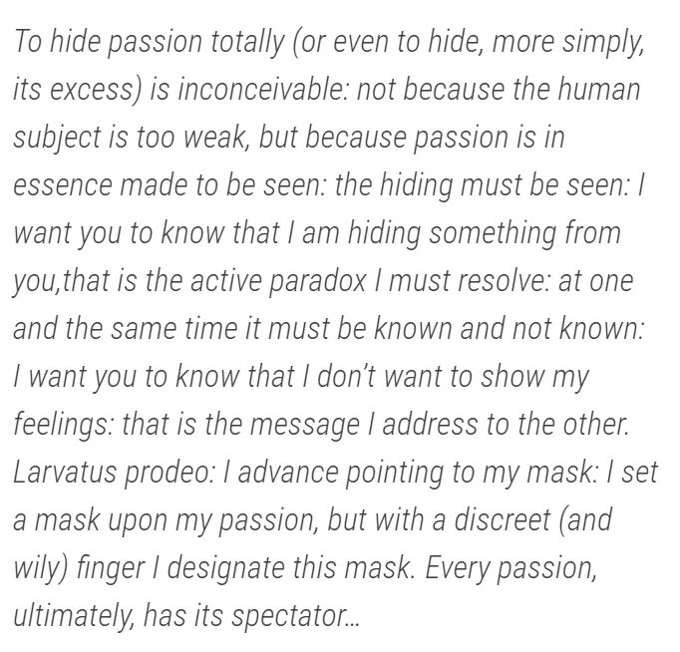
Why do any of this?
Documenting this process of data collection, cleaning, and refinement is intended to build my audit trail (Rodgers & Cowles, 1993). An audit trail is intended to make any data modification practices (see Chu et al, 2016) transparent contributing to an internal validity.
In doing so, I am rendered visible within the research, as the researcher.
Barthes (1977) on Larvatus prodeo

Slide 13
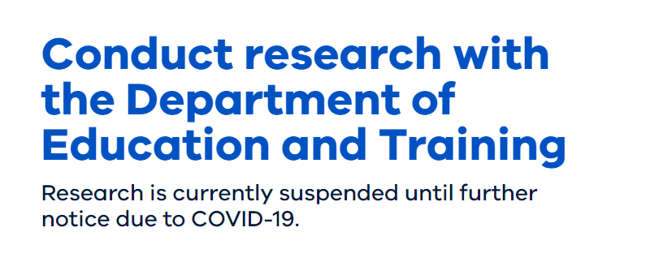
Limitations - research in the time of COVID-19

Slide 14
Methodological choices

Slide 15
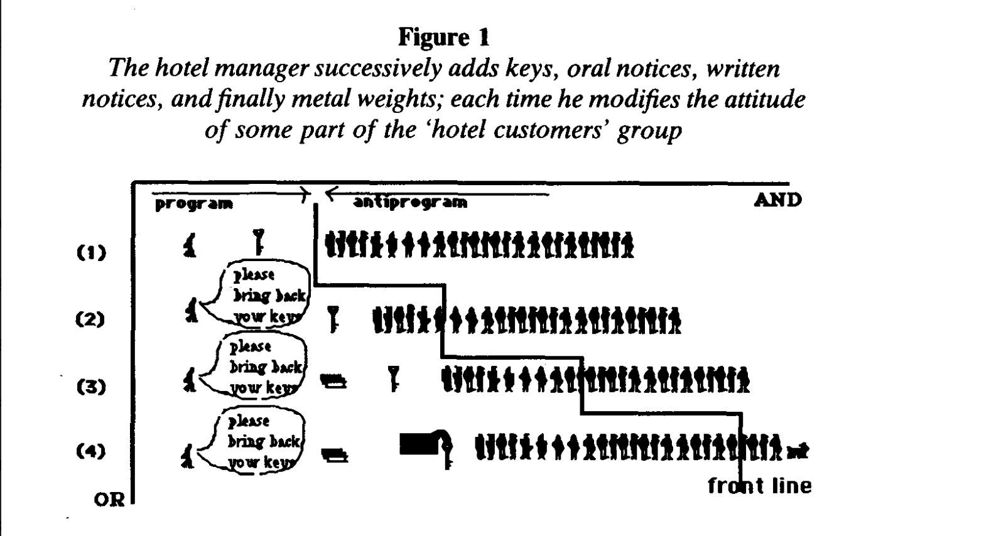
Underlying epistemological position regarding digital (media) literacy
Goffman-esque (1959) understanding of ‘literacy’ as a type of performance(s) conducted based on context and a focus on ‘definitional disruptions’. There can therefore be no ‘True’ literacy, rather multiple, overlapping, parallel, and sometimes conflicting literacies.
Technology also seen as agentic, not seen as a ‘neutral’ or ‘passive’ object (Latour, 1990).

Slide 16
How does your method allow you to answer your research question?
Ethnographically-inspired thick description (Geertz, 2008) ensures centring of participants voices, while Larvatus prodeo (Barthes, 1977) ensures my researcher positionality is present.
Working with developers and schools ensures all voices in an app’s lifecycle are present, reflects ‘messy’ reality of technology (Latour, 1990).
Ultimately centres the human, rejects technological determinism through non-media-centric media studies (Couldry, 2010)

Slide 17
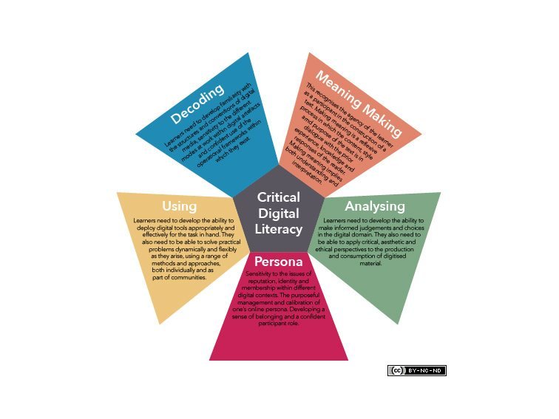
How is your definition of digital (media) literacy reflected in your methods?
Derived from studies of critical digital literacy - e.g. Pangrazio (2016); Ávila & Pandya (2013). Questions both everyday experience of digital media use and the political economy of EdTech sector.
Resists notion of ‘digital native’ (Prensky, 2001; Selwyn, 2009), again centring young people and their experiences, rather than assuming tacitly acquired knowledge.

Slide 18
To what extent does your method allow to redefine your research question?
i. How does each actor within the circuit of the app interpret and use the apps in my study?
ii. How do the apps in my study shape and get shaped by the everyday routines and habits of schooling?
iii. What role do the apps in my study play in how schooling is administered and how learning is understood?
While RQs are ‘neat’ (separating out different types of actors), groundwork-driven method necessitates ‘messier’ results.
These ‘messy’ relationships question the separation of elements found in circuit of culture model (du Gay et al, 1997), necessitating a model which is further interconnected - the concentric zone model.

Slide 19
Researcher-participant relationships
Treating participants as research partners and ensuring reciprocity:
Thick description seeks to disprove researcher notions, rather than affirming them.
Participants recruited with app companies and school staff, in the pursuit of co-design.
Research findings will be provided to participant bodies in a tailored form after submission
Addressing researcher-participant power imbalances.
Interviews designed to empower participants through ‘home advantage’ through on-site visits e.g. to development company offices, teachers’ staff rooms, admin offices, etc.
Student focus groups conducted as a round table, physically decentring the researcher and allowing for young people to explore topics and the space as they see fit.

Slide 20
Reflexive questions
How to develop RQs which will correspond with, rather than need refining from, ‘messy’ research findings?
How to identify research partners (particularly schools) earlier, to build co-design into research from the beginning?
How to be available for participants after the research, to ensure a relationship of reciprocity exists?

Slide 21
Bibliography I
Ávila, J., & Pandya, J. Z. (2013). Critical Digital Literacies as Social Praxis: Intersections and Challenges. Peter Lang. New York.
Barthes, R. (1977). Mourning diary. Hill and Wang, NY.
Chu, X., Ilyas, I. F., Krishnan, S., & Wang, J. (2016, June). Data cleaning: Overview and emerging challenges. In Proceedings of the 2016 international conference on management of data (pp. 2201-2206).
Couldry, N. (2012). Media, society, world: Social theory and digital media practice. Polity Press, Oxford.
Du Gay, P., Hall, S., Janes, L., Madsen, A. K., Mackay, H., & Negus, K. (1997). Doing cultural studies: The story of the Sony Walkman. Sage, London.
Geertz, C. (2008). Thick description: Toward an interpretive theory of culture (pp. 41-51). Routledge, London.
Goffman, E. (1959). The presentation of self in everyday life. Garden City, NY, 259.

Slide 22
Bibliography II
Latour, B. (1990). Technology is society made durable. The sociological review 38 (1), 103-131.
Light, B., Burgess, J., & Duguay, S. (2018). The walkthrough method: An approach to the study of apps. New media & society, 20 (3), 881-900.
Ong, B. K. (2012). Grounded Theory Method (GTM) and the Abductive Research Strategy (ARS): a critical analysis of their differences. International Journal of Social Research Methodology, 15(5), 417-432.
Pangrazio, L. (2016). Reconceptualising critical digital literacy. Discourse: Studies in the cultural politics of education, 37 (2), 163-174.
Pink, S. (2016). Digital ethnography. Innovative methods in media and communication research, 161-165.
Prensky, M. (2001). Digital natives, digital immigrants part 2: Do they really think differently?. On the horizon. 9 (6). 1-6
Rodgers, B. L., & Cowles, K. V. (1993). The qualitative research audit trail: A complex collection of documentation. Research in nursing & health, 16 (3), 219-226.
Selwyn, N. (2009). The digital native–myth and reality. In Aslib proceedings. 61 (4). 364-379.

