Slide 1




Defining and analyzing media literacy competence starting with the observation of media practices: an interpretive approach
ReDMIL 2022
Pierre Fastrez & Jerry Jacques
« two scientists ready for their keynote in the style of Hokusai »
Generated with Dall-E

Slide 2

An interpretive methodological approach
Why bother ?
Observations, interviews, coding data… ⇒laborious, time-consuming
A well-stablished theoretical approach of literacies (e.g. Jenkins et al.’s, 2006)
➔ Explore and clear a complementary route : an intepretive methodological approach
« a very competent scientist solving problems in the style of Hokusai »
Generated with Dall-E

Slide 3
An interpretive methodological approach
Our assumption: media literacy as a form of competence
The french-speaking competence-based approach :
  Intentional action, driven by an operational purpose (Gillet 1998; Rey et al. 2012)
  Selection and combinaison of resources to respond to complex situations in non-stereotypical ways (Tardif 2006; Rey et al. 2012)
  Observable through performance (Scallon 2004; Bulea & Bronckart 2006)
  Situated (Tardif 2006; Rey et al. 2012)
  Biographically integrated
Consequence: "an agnostic stance towards the object of study" (Ligurgo et al. 2019: 14)

Slide 4

An interpretive methodological approach
One constraint: studying media practices to anchor competence theorization
⇒ Practices are the ground for the deployment of competence
Practice as "organized nexus of actions", as "a set of doings and sayings" (Schatzi, 2002)
Practices are inseparable from the meaning that individuals invest in them (Knobel & Lankshear, 2007, p. 2).
Involving bodily and mental activities, but also things, background knowledge, know-how, emotions, motivations (Reckwitz, 2002)
Literacy “a set of socially organized practices which make use of a symbol system and a technology for producing and disseminating it” (Scribner & Cole, 1981)
"a scientist doing interviews about digital media in the style of Hokusai" Generated with Dall-E

Slide 5
An interpretive methodological approach
Based on these considerations, we can define media practices as routinized, habitual bundles of meaningful socially shared and coordinated activities that involve media in several respects: as technological tools and as symbol systems for producing and receiving meanings, but also as objects of specific knowledge and skills associated with their use, of shared interests and emotional investments.

Slide 6
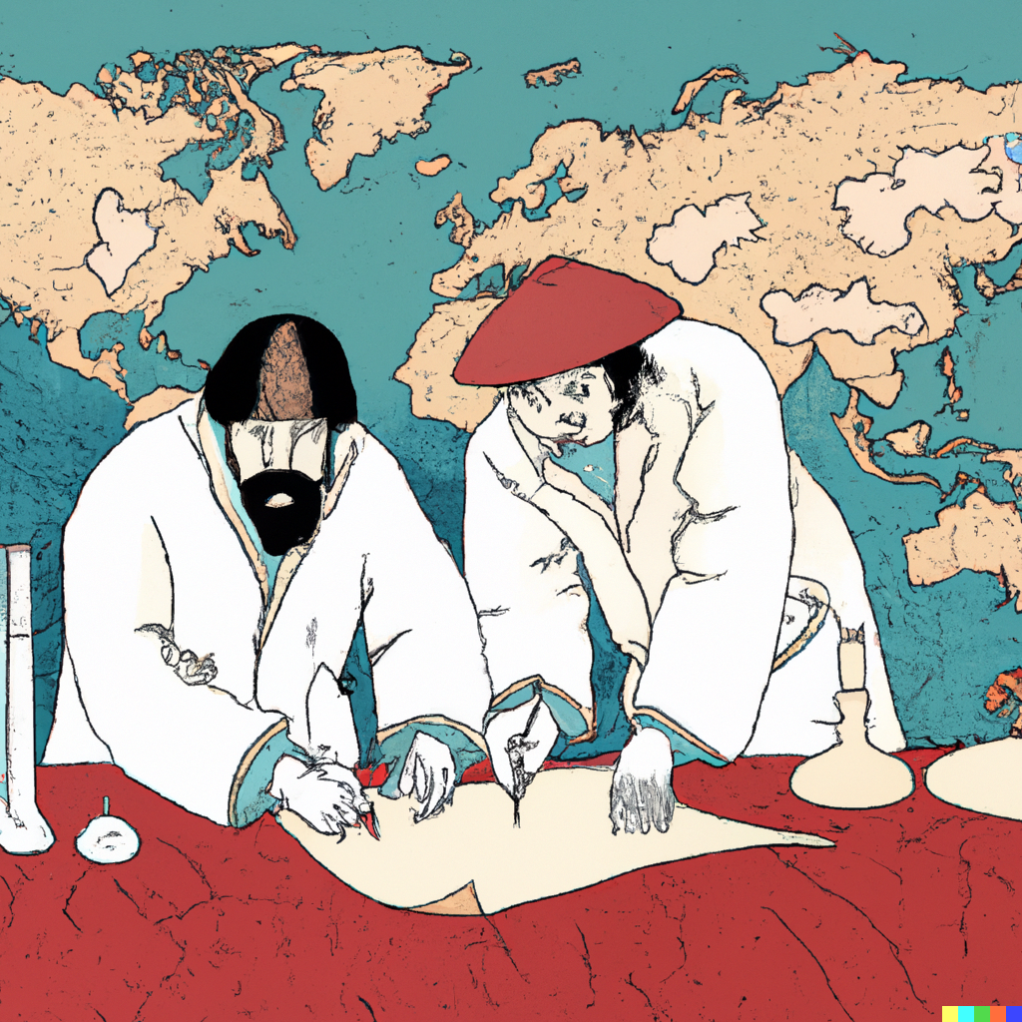
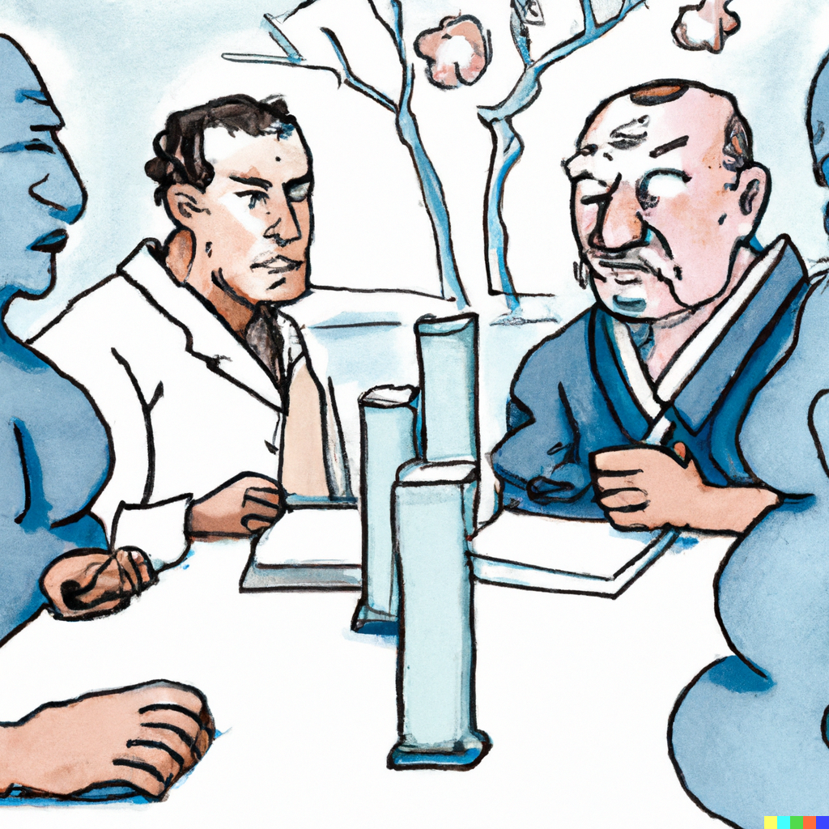

An interpretive methodological approach
Three challenges : theorizing ordered competencies from the apparent chaos of practices
The boundaries challenge: how can media practices be delineated within the whole of human behavior ?
The competence challenge: how to define what people are or should be able to do based on what they do?
The normativity challenge: how to deal with the inevitable normative force of any competence definition ?

Slide 7
Two case studies
PIM
⇒ defining digital personal information management competence (Jacques, 2016)
Method :
28 students
Interviewed twice (before/after HE)
Guided-tour interviews of their personal space of information
LITME@WORK
⇒ defining media literacy competence needed for collaborative and distant work (Ligurgo, 2019)
Method:
41 workers, 20 managers
Interviews
Ethnographic observations

Slide 8
I. The boundaries challenge
Media practices: not an absolute distinction, a question of perspective
Multiple media practices may be intertwined within any given ‘domain of life’ (Barton & Hamilton 2000)
A double challenge
  Identifying the "media" part of social practices
  Choosing a scope, setting boundaries: the "unit of practice"
    Nested character of human purposeful behavior (Scribner & Cole 1981)
"two scientists drawing a map in the style of Hokusai"
Generated with Dall-E

Slide 9
I. The boundaries challenge
Finding out how media practices can be “divided up into speciﬁc practices, and how those practices are coordinated with each other” (Couldry 2004: 121) calls for adopting the studied actors’ perspective
  How people themselves categorize their practices
  "an agnostic stance towards the object of study"
Not a purely inductive endeavor: existing theoretical categories may help... at multiple levels
  PIM as a conceptual category
  CSCW as a source of categories for distant teamwork in LITME@WORK
Delineating media practices empirically: start with medium-based or activity-based common sense categories

Slide 10
I. The boundaries challenge
Medium-based inquiry
Identifying the boundaries of a media practice based on what people do to and with specific technical apparatus
Using the materiality, tangibility or concreteness of media equipment as a methodological opportunity
  Informants can easily identify the (hardware and software) equipment they use to elaborate on how and why they use it
Activity-based inquiry:
Activity as being defined by a motive, or what one seeks to achieve or obtain (Kaptelinin 2013).
Can be initially deductive (LITME@WORK)
Combining both:
PIM: "How do you organize your personal digital information?" And "What technical devices do you use to organize your personal information?" as starting points for interviews

Slide 11
II. The competence challenge
The challenge : from practices to competences
How to characterize both the unicity of practices and the variety of competence levels that correspond to them, at the intersection of
  the types of situations they cover,
  the types of goals individuals pursue through them,
  and the resources they are able to make use of in them.
Neither practices nor competencies are directly manifest.
From practices to competence: a two-step connection
  Media literacy events
  Media literacy situations
"a scientist having to decide who are the more competent in the style of Hokusai"
Generated with Dall-E

Slide 12
II. The competence challenge
framed by participants as...
Events
Competencies
  Doings and sayings
  Meaningful, socially shared and coordinated activites
  Include values, meanings, intentions, attitudes and… competencies
  Any occasion in which media are integral to the nature of participants’ interactions and their interpretive processes
  media literacy events as they are framed by the individual
  Manifest in participants’ discourse (interviews)
  ability to “frame” a situation:
    to identify its relevant dimensions
    to determine the appropriate combination of resources that are necessary to take action in the situation
=
Practices
Situations
Observable through...
define (levels of)...

Slide 13
II. The competence challenge
Phenomenography (Marton 1981, 1986) as an inspiration
  Describing experiences = second-order perspective
  Focus on variation between "conceptions" of the same phenomenon
Goal: describing the qualitatively different ways in which similar media literacy events can be framed as situations in which to act competently
    “[A] capability for acting in a certain way reflects a capability experiencing something in a certain way. The latter does not cause the former, but they are logically intertwined. You cannot act other than in relation to the world as you experience it.” (Marton and Booth 1997: 111)
➔ Implications for sample selection, collected data and data analysis

Slide 14
II. The competence challenge
Data collection: sample selection
Conceptions of practices are sampled, not individuals
Variation in participants is a bet on the variation of conceptions
  Participant profiles (Sandberg 2000: education and work experience)
  Participant change (Jacques 2016: before and after high school graduation)
  Multilevel variation (LITME@WORK: organizations > teams > individuals)
Theoretical sampling (iterative or not) and data saturation

Slide 15
II. The competence challenge
Collected data: interviews and observations
Participant discourse, traces and direct observation
Guided tour interviews (Thomson, 2018)
  Video-recorded "Demonstrative" interviews: tour + showcase
  Location and demonstrative nature of interview foster the elicitation of practices
  Extending the periphery of (the description of) practices – environmental cueing
  Interview guide
    = few instructions, many follow-up questions/prompts
    can change over the course of the project
    Focus on one category (e.g. PIM) or several (e.g. LITME)

Slide 16
II. The competence challenge
Data analysis: Inferring Competence Definitions from Descriptions of Practices
Identify qualitatively different ways of experiencing a media practice
  differentiated on the basis of its constitutive dimensions, as apprehended and articulated by the informants.
The same practice (e.g. organizing a digital music library, or planning a work meeting) can be viewed as a more or less complex articulation of different relevant dimensions.
  “Relevant” is defined here from the perspective of the informant.

Slide 17
II. The competence challenge: LITME@WORK results
Area | > Activity | Tasks | Time | Space / Distance | Information | Technology | People
Interdependent Tasks
 | > Collectively allocating tasks (coordination work)
 | > Implementing tasks interdependency (cooperation work)
Team Meetings
 | > Organizing team meetings (coordination work)
 | > Meeting with the team members (cooperation work)
Remote Communication
 | > Organizing means of communication (coordination work)
 | > Communicating with coworkers (cooperation work)
Information Spaces
 | > Organizing shared information spaces (coordination work)
 | > Sharing information in dedicated spaces (cooperation work)
Document Production
 | > Organizing the collective authoring of a document (coordination work)
 | > Authoring a document collectively (cooperation work)

Slide 18
II. The competence challenge: LITME@WORK results
Area | > Activity | Tasks | Time | Space / Distance | Information | Technology | People
Interdependent Tasks
 | > Collectively allocating tasks (coordination work)
 | > Implementing tasks interdependency (cooperation work)
Team Meetings
 | > Organizing team meetings (coordination work) |  |  |  | • | • | •
 | > Meeting with the team members (cooperation work)
Remote Communication
 | > Organizing means of communication (coordination work)
 | > Communicating with coworkers (cooperation work)
Information Spaces
 | > Organizing shared information spaces (coordination work)
 | > Sharing information in dedicated spaces (cooperation work)
Document Production
 | > Organizing the collective authoring of a document (coordination work)
 | > Authoring a document collectively (cooperation work)
Organizing team meetings> Identify the most appropriate time to meet:
  "I just click on the calendars here. I look at the time slot, see if they're here or not, see if it's with external appointments, I don't touch it. Sometimes if we have an internal staff [meeting], I know there's a way to negotiate. But this is super convenient." (team leader)

Slide 19
II. The competence challenge: LITME@WORK results
Area | > Activity | Tasks | Time | Space / Distance | Information | Technology | People
Interdependent Tasks
 | > Collectively allocating tasks (coordination work)
 | > Implementing tasks interdependency (cooperation work)
Team Meetings
 | > Organizing team meetings (coordination work) |  | • |  |  | •
 | > Meeting with the team members (cooperation work)
Remote Communication
 | > Organizing means of communication (coordination work)
 | > Communicating with coworkers (cooperation work) |  |  | • | • | • | •
Information Spaces
 | > Organizing shared information spaces (coordination work)
 | > Sharing information in dedicated spaces (cooperation work)
Document Production
 | > Organizing the collective authoring of a document (coordination work)
 | > Authoring a document collectively (cooperation work)
Organizing team meetings> Identify the most appropriate time to meet:
  "For the team meeting, the dates and time are chosen at the beginning of the year, together. I'm usually the one who does the planning. Are they respected? I don't think so. On the one hand I can understand it, we exchange on the field every day. Is it necessary to have team meetings every week? (...) Skype has 3 functions that I use regularly. I check the status... My direct team is here in the building, they are actively working on their PCs, that's why they have the little green "V". [First name] said she's at home, her status is on orange, so I know she's not behind her PC right now. Here for example I see another person [...] who has the red status, she is in a meeting. This is linked to your Outlook calendar. (...)" (team member)

Slide 20
II. The competence challenge
Data analysis: Inferring Competence Definitions from Descriptions of Practices
Analysis of interview transcripts
Becoming familiar with the material to identify described media literacy events
Coding iteratively: grouping conceptions of the "same" events / practices (referential aspect of conception)
Generate categories = alternative conceptions of the same practices
  Both between- and within-participant comparisons of descriptions
  A process that can be inductive or combine induction and deduction
  Multiple judges and inter-judge agreement
Output (outcome space): conceptions ordered from least to most complex

Slide 21
III. The normativity challenge
The challenge : defining competence implies to order practices through comparison and judgment (about success, failures, efficiency, efficacy...)
Problem : the criteria to do this work are not directly accessible
everyday routines, habitual behavior
objectives and conditions for success not made explicit, unspoken, sometimes unconscious
idyonsyncratic lived experiences, personal preferences
Goal: producing intepretations that
⇒ are attentive to the way in which individuals frame their own practices, without artificially imposing the researcher's point of view
⇒ are trying to keep an expected axiological neutrality (understanding how people judge themselves instead of judging them)
"a scientist dealing with the normativity issues of his work in the style of
Hokusai"
Generated with Dall-E

Slide 22
III. The normativity challenge
⇒ We can lean towards intersubjectivity by a careful documentation of practices, by analysing how individuals
Define their problems and how they find (or not) solutions to them;
The quality and variety of the ressources they mobilize;
Their satisfaction / insatisfaction;
The richness, diversity and complexity of their practices with regards to their goals.
⇒ despite these efforts we can't avoid the normative force of any competence definition
"Rather I would propose that we should examine that situation as an anthropologist would examine culture or sub-culture, making explicit the judgements we would make from our own cultural and structural situations in order to discover how and why the structures to be identified there generate particular conceptions and perceptions amongst the actors themselves" (Street, 1984, p. 217).

Slide 23
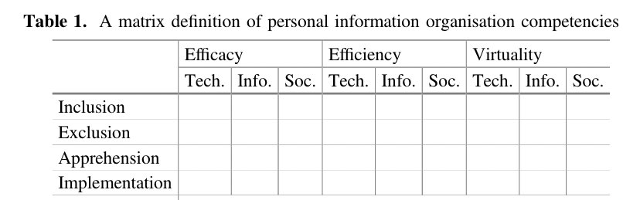
III. The normativity challenge
A possible path to tackle this challenge :
⇒ acknowledging this normativity, and making it explicit for the actors concerned in the broader social space
⇒ competence definition as reflexive and usable tools, not only for researchers and educators

Slide 24
Conclusion
⇒ Our approach tries to build intelligibility and common ground.
⇒ Media literacy actions which are meaningul for the social actors because they are anchored in the complexity of their lived experience
⇒ Competences not as an overarching truth, defined once and for all by experts, but as reflexive tools supporting a shared and meaningful media literacy.

Slide 25

Conclusion
« two scientists grateful for their audience’s attention and ready to answer questions in the style of Hokusai »
Generated with Dall-E

Slide 26
References
Barton, D., & Hamilton, M. (2000). Literacy practices. In D. Barton, M. Hamilton, & R. Ivanič (Éds.), Situated literacies : Reading and writing in context (Vol. 7, p. 7‑15). Routledge.
Bulea, E., & Bronckart, J.-P. (2006). La saisie des compétences dans l’interprétation de l’activité de travail. Bulletin Vals/Asla, 84, 143‑171.
Couldry, N. (2004). Theorising media as practice. Social Semiotics, 14(2), 115‑132. https://doi.org/10.1080/1035033042000238295
Gillet, P. (1998). Pour une écologie du concept de compétence. Education permanente, 135, 23‑32.
Jacques, J. (2016). Définition des compétences propres à l’organisation des collections d’informations personnelles numériques [Dissertation doctorale, UCL - Université Catholique de Louvain]. https://dial.uclouvain.be/pr/boreal/en/object/boreal%3A174446
Jenkins, H., Purushotma, R., Clinton, K., Weigel, M., & Robison, A. J. (2006). Confronting the Challenges of Participatory Culture : Media Education for the 21st Century (The John D. and Catherine T. MacArthur Foundation Reports on Digital Media and Learning) [White paper]. The John D. and Catherine T. MacArthur Foundation. http://digitallearning.macfound.org/atf/cf/%7B7E45C7E0-A3E0-4B89-AC9C-E807E1B0AE4E%7D/JENKINS_WHITE_PAPER.PDF
Knobel, M., & Lankshear, C. (Éds.). (2007). A New Literacies Sampler. Peter Lang Inc., International Academic Publishers.
Ligurgo, V. (2019). Le travail collaboratif à distance : Cartographie des compétences en littératie médiatique : le cas du travail de bureau soutenu par les technologies de l’information et de la communication (TIC) [Dissertation doctorale, UCL - Université Catholique de Louvain]. https://dial.uclouvain.be/pr/boreal/object/boreal:221188
Ligurgo, V., Fastrez, P., Jacques, J., Collard, A.-S., & Philippette, T. (2019). A Definition of Digital Media Literacy Competences Required by Workers to Collaborate in Distance Work Environments. In J. Jacques & A.-S. Collard (Éds.), Digital Media Literacy in Teamwork and Distance Work : Competences, Discourse and Organizational Design (p. 13‑68). Presses Universitaires de Namur. https://dial.uclouvain.be/pr/boreal/object/boreal:223556
Marton, F. (1981). Phenomenography—Describing conceptions of the world around us. Instructional Science, 10(2), 177‑200. https://doi.org/10.1007/BF00132516
Marton, F. (1986). Phenomenography—A Research Approach to Investigating Different Understandings of Reality. Journal of Thought, 21(3), 28‑49.
Marton, F., & Booth, S. A. (1997). Learning and Awareness. Psychology Press.
Reckwitz, A. (2002). Toward a Theory of Social Practices : A Development in Culturalist Theorizing. European Journal of Social Theory, 5(2), 243‑263.
Rey, B., Carette, V., Defrance, A., & Kahn, S. (2012). Les compétences à l’école : Apprentissage et évaluation. De Boeck.
Sandberg, J. (2000). Understanding Human Competence at Work : An Interpretative Approach. The Academy of Management Journal, 43(1), 9‑25. https://doi.org/10.2307/1556383
Scallon, G. (2004). L’évaluation des apprentissages dans une approche par compétences (2e éd.). De Boeck Université.
Schatzki, T. R. (2002). The Site of the Social : A Philosophical Account of the Constitution of Social Life and Change. Pennsylvania State University Press.
Scribner, S., & Cole, M. (1981). The Psychology of Literacy. Harvard University Press.
Street, B. V. (1984). Literacy in Theory and Practice. Cambridge University Press.
Tardif, J. (2006). L’évaluation des compétences : Documenter le parcours de développement. Chenelière éducation.
Thomson, L. (2018). The Guided Tour : A Research Technique for the Study of Situated, Embodied Information. Library Trends, 66(4), 511‑534. https://doi.org/10.1353/lib.2018.0015

