Slide 1


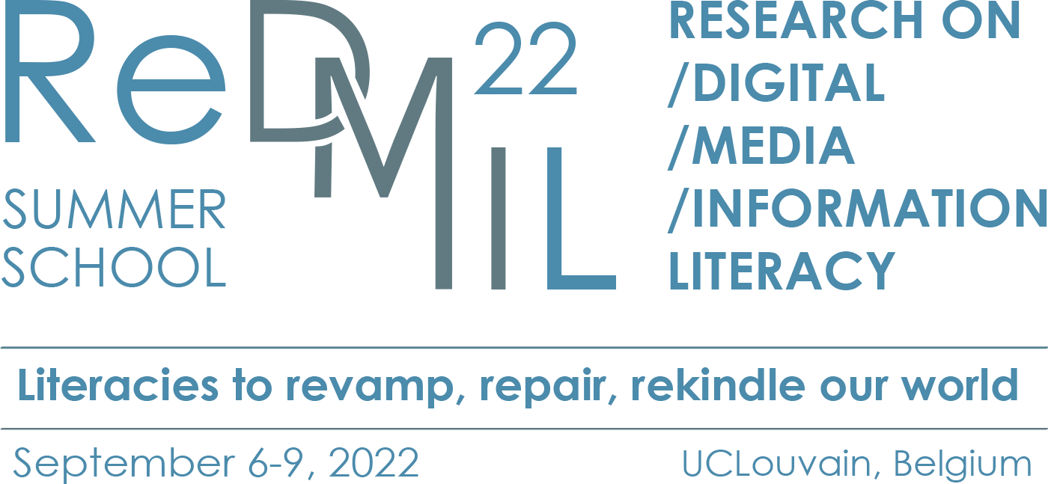
The potential of the archived web for scholarly use
Presentation #1: Theoretical frameworks, research questions and axiological positions
7 september 2022, RedMIL Summer School
Eveline Vlassenroot, Ghent University

Slide 2
Content
Problem statement
Research question(s)
Conceptual framework
Axiological position
Expected findings

Slide 3
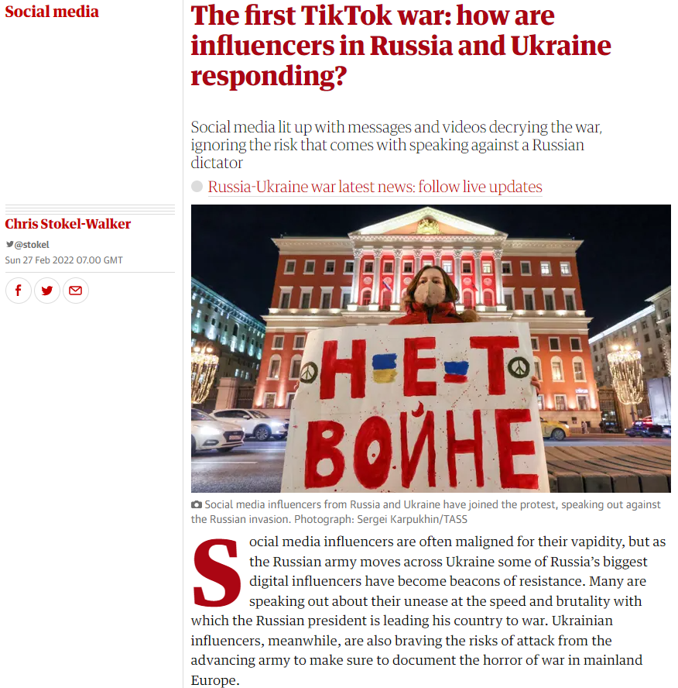
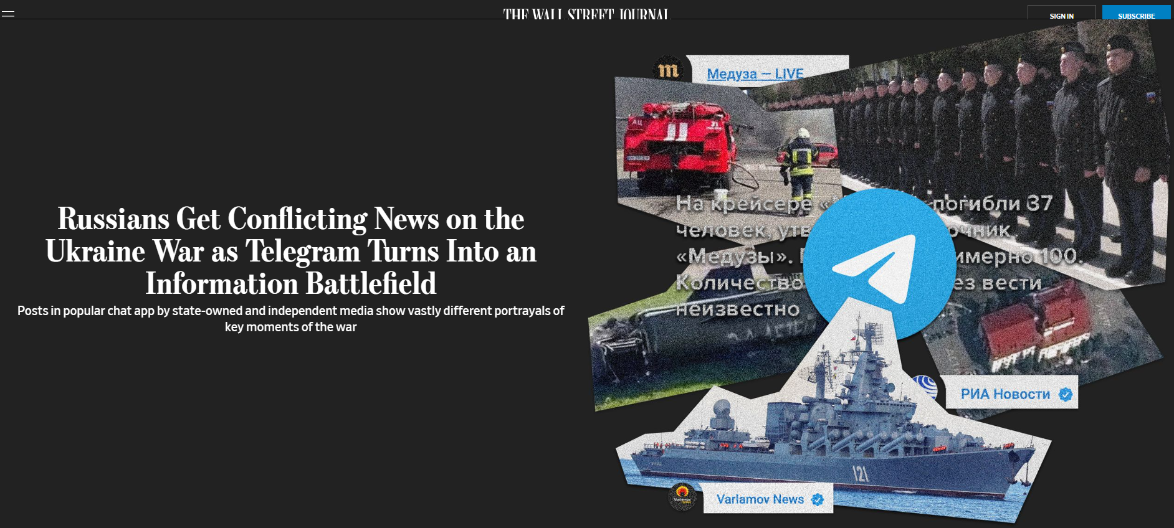
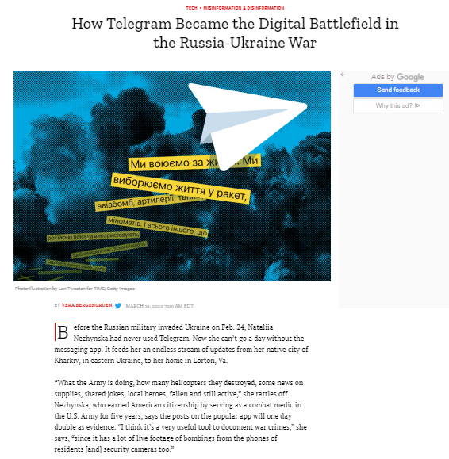
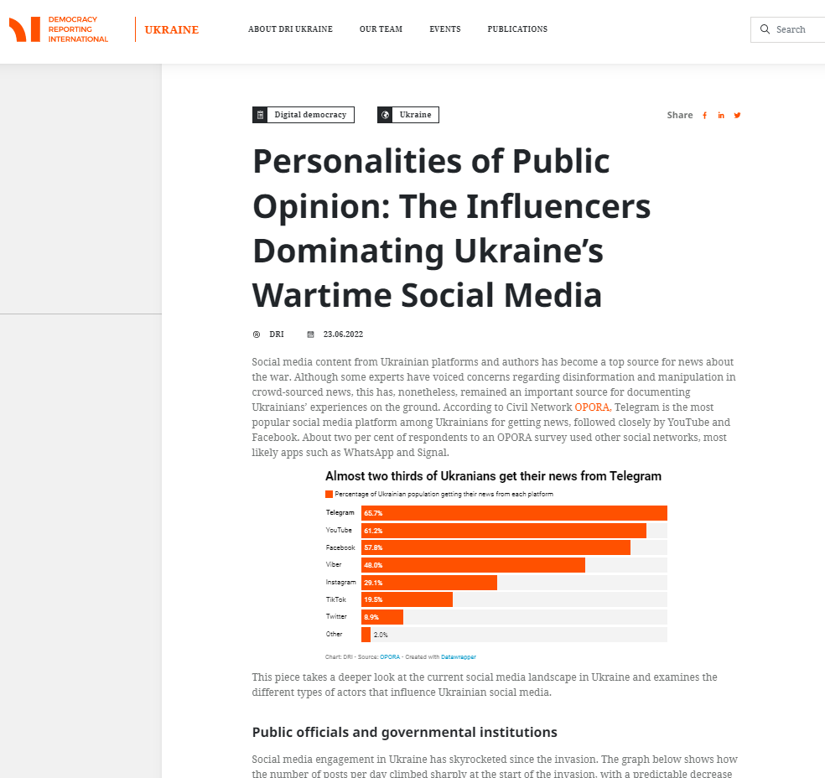
The Web as an important footprint of the past
Source:
https://www.wsj.com/articles/russians-get-conflicting-news-on-the-ukraine-war-as-telegram-turns-into-an-information-battlefield-11654314693
Source: https://www.theguardian.com/media/2022/feb/26/social-media-influencers-russia-ukraine-tiktok-instagram
Source: https://time.com/6158437/telegram-russia-ukraine-information-war/
Source: https://democracy-reporting.org/en/office/ukraine/publications/personalities-of-public-opinion-the-influencers-dominating-ukraines-wartime-social-media
1.Problem statement
Notes:
I am of course kicking in the open when I say that the web is playing an increasingly important role in our daily lives and communication. We can no longer imagine the web in our daily functioning, the corona pandemic also accelerated this. This also means that the web contains more and more traces of our history, making it a potential treasure trove of information, including information created by the 'ordinary person in the street'. A lot is posted online, content and images that help shape history. However, there is a problem: the short lifespan of this online information. The web is constantly evolving and content is lost.
On the slide I show the example of an article that suggests that infographics on Instagram help to tell the story of the Israeli-Palestinian crisis. This is relevant material for examining the image of this crisis. Unfortunately, many Instagram posts or stories have already been removed.

Slide 4
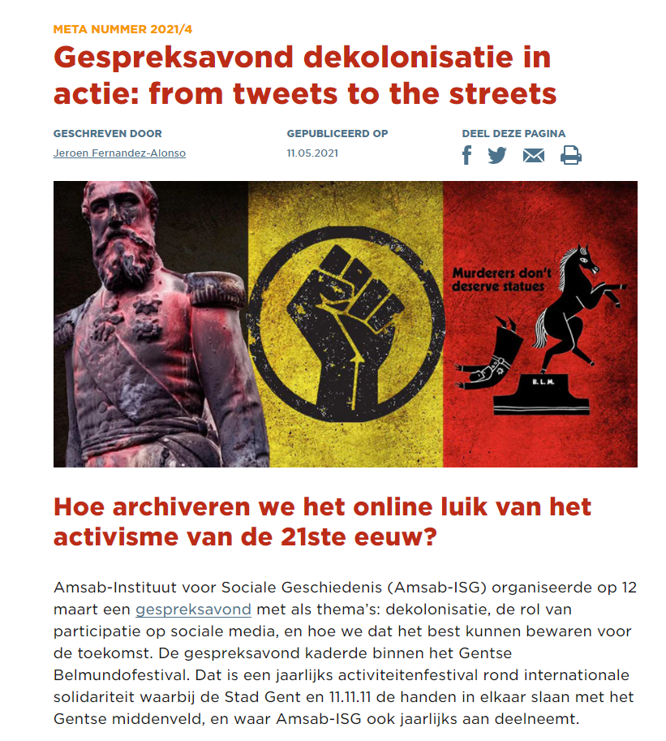
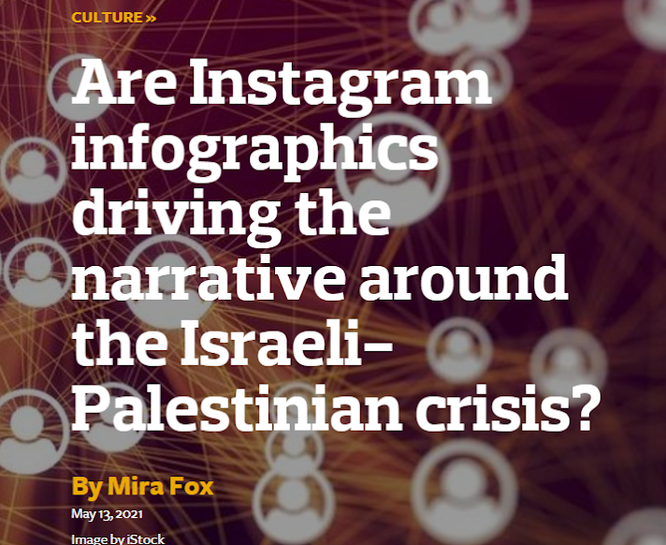
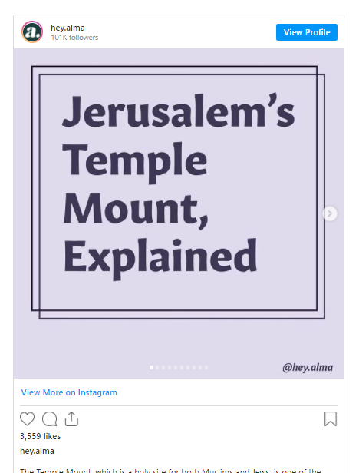
Relevance for researchers
Notes:
On the slide I show the example of an article that suggests that infographics on Instagram help to tell the story of the Israeli-Palestinian crisis. This is relevant material for examining the image of this crisis. Unfortunately, many Instagram posts or stories have already been removed.

Slide 5
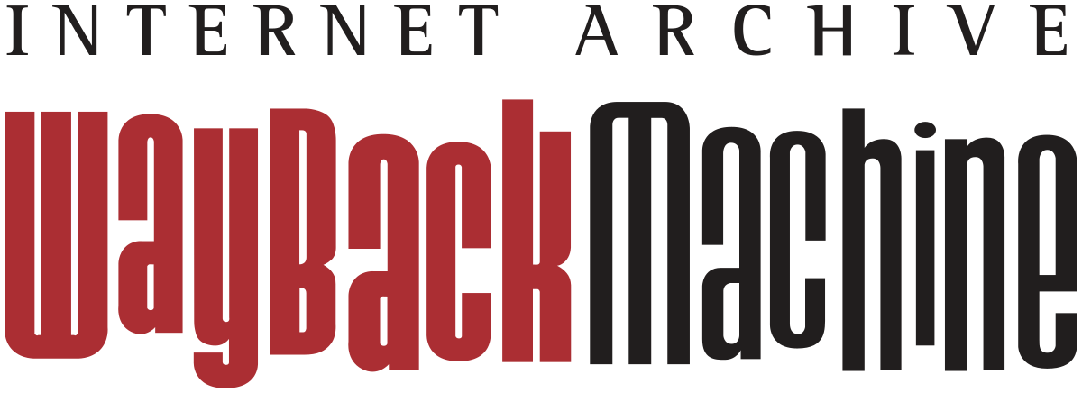
International web archives since 1996 …
1996
Australia: PANDORA
UK Government web archive
Internet Archive: WaybackMachine
1999
New Zealand web archive
2001
Norwegian web archive
1997
Sweden: Kulturarw3
2000
USA: Library of Congress web archive
Czech Republic: Webarchiv
2002
France: BnF web archive
Notes:
Abroad, we see that in some cases national libraries and archives were they archive this content as early as the early days of the web. In 1996 they already started in Australia and the United Kingdom. In the years that followed, more and more initiatives arose.

Slide 6

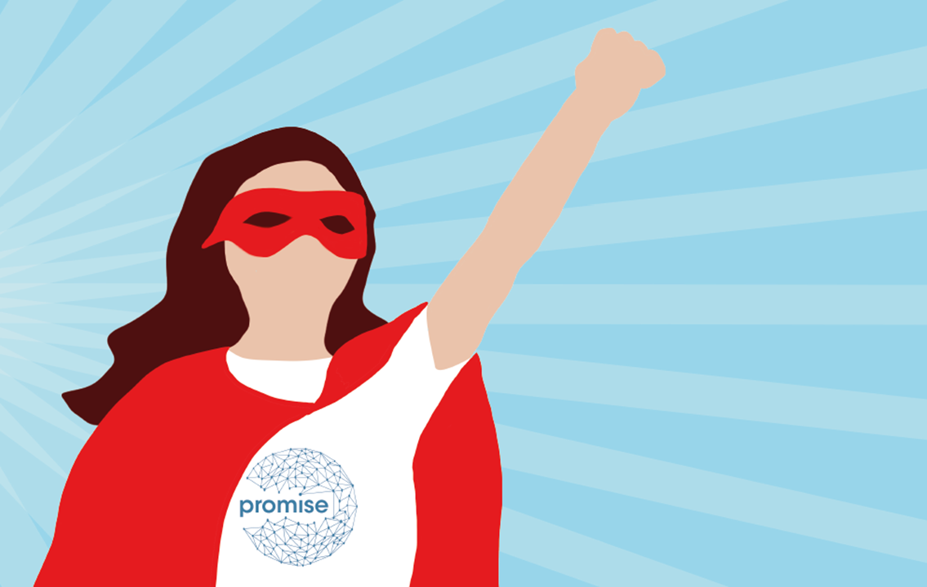
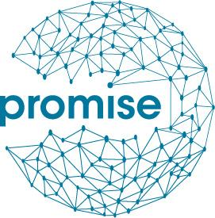
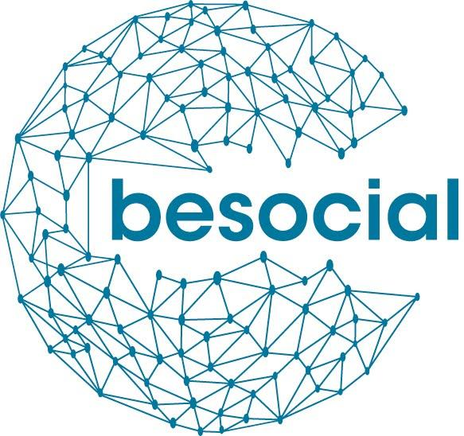
… but what about Belgium?
2017 – 2019
Focus on
archiving websites
2020-2022
Focus on
social media
archiving
Upcoming project: 2023-2025 BelgicaWeb
Notes:
The Belgian web is currently not systematically archived. There are a number of web archiving initiatives on a smaller scale in Belgium, such as in the Felix Archive, which archives the websites and social media of the city of Antwerp, or at the AMSAB, but there is no initiative (yet) at the federal level. That is why the initiative of the promise project was taken by the State Archives and the National Library. Other partners in the project were the universities of Ghent and Namur and the university college Bruxelles-Brabant.
Het Belgische web wordt momenteel niet systematisch gearchiveerd. Er bestaan een aantal webarchiveringsinitatieven op kleinere schaal in België zoals bijvoorbeeld in het Felixarchief die de websites en sociale media van de stad Antwerpen archiveert of aan het AMSAB, maar op federaal vlak bestaat er (nog) geen initiatief. Daarom werd het initiatief van het promise project genomen door het Rijksarchief en de Nationale Bibliotheek. Andere partners in het project waren de universiteiten van Gent en Namen en de hogeschool Bruxelles-Brabant.
Vanuit dit Promise-project (dat intussen afgelopen is) realiseerden we ons dat de archivering van sociale media - en dus van born digital data - in België een belangrijk onderdeel is van ons cultureel erfgoed. Vanuit die context ontstond er een nieuw project dat vorig jaar werd opgestart: Besocial. In dit project streven we ernaar een duurzame strategie te ontwikkelen voor het archiveren en bewaren van sociale media in België, om zo ons online nationaal erfgoed te documenteren voor toekomstige generaties.

Slide 7
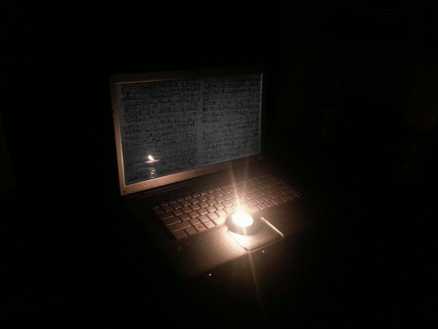



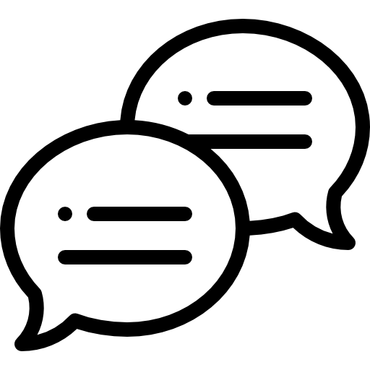


Challenge 1: Short lifespan of online data
Icons made by Vectors Market & Pixel Market from www.flaticon.com
Notes:
However, the short lifespan of online data (with 40% of content being removed after 1 year) (Brügger, 2005, p.15) poses serious challenges for preserving and safeguarding digital heritage and information.

Slide 8
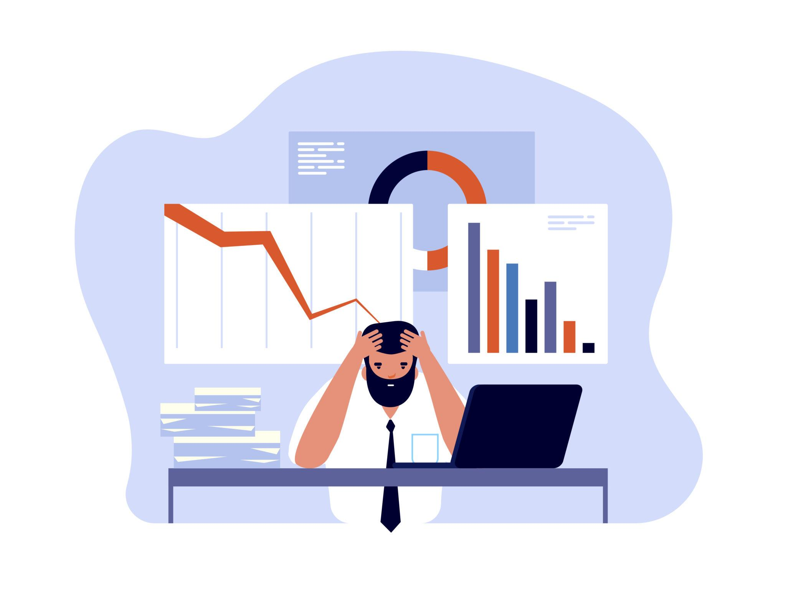
Challenge 2: Appropriate data analysis
Source: https://www.inzata.com/the-7-most-common-data-analysis-mistakes-to-avoid/
Notes:
With the increasing ability to digitize text and collections, automate data collection, conduct large scale surveys and generate vast genomic, geophysical or other types of data, there is the great potential to conduct data-driven research or/and research driven approach and address questions in all fields that were not previously possible. However, despite this promise and given that web archived content is relatively new research material, analysis of these datasets presents a major challenge.

Slide 9
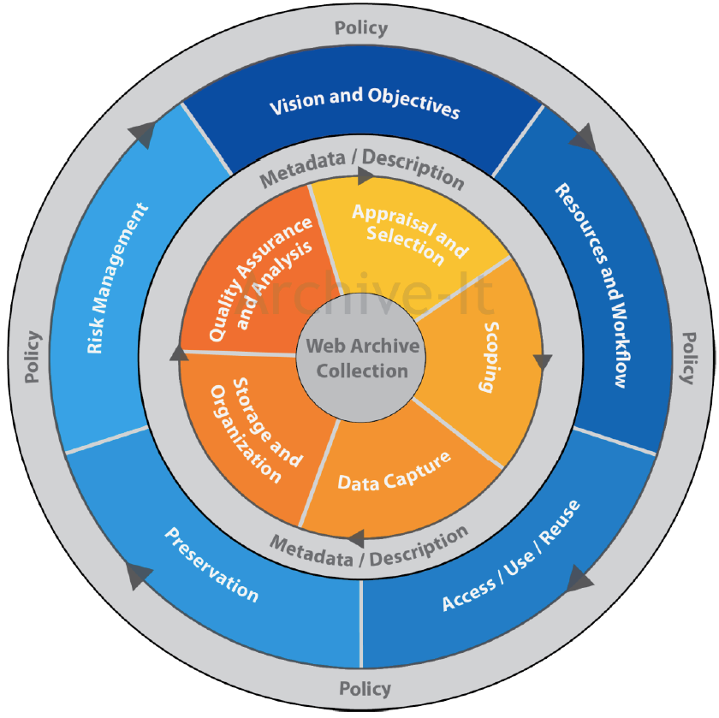
Challenge 3: Development of web archives
Source: Web Archive IT Lifecycle Model
Source: https://www.inzata.com/the-7-most-common-data-analysis-mistakes-to-avoid/

Slide 10
Research question
RQ: What is the potential of web archived content for scholarly use?
RQ1: What knowledge, values and skills are needed for researchers to work with web archives?

Slide 11
What is “web archiving”?
Web archiving is the process of gathering up data that has been recorded on the World Wide Web, storing it, ensuring the data is preserved in an archive, and making the collected data available for future research. (Niu, 2012)
The web archive as a form of “media” as it channels cultural productions (collections). Like other forms of media, technical infrastructure, design, funding, role expectations, and distribution methods shape the digital archive. (Jensen, 2021)
Notes:
A web archive is “any form of deliberate and purposive preservation of web material”¹. Some examples of web archives can be found here:
An archive (digital or not) is comparable to other media as it channels cultural productions (collections), just as a radio-channel or a website make content available to their users. Like other forms of media, technical infrastructure, design, funding, role expectations, and distribution methods shape the digital archive. Archives are, when they become available online, part of a digital cyberinfrastructure. When archival institutions produce collections, they become part of a digital landscape with its particular logic of production and distribution. This shapes the archive as a cultural form, as a medium, and it means that the framework needs to prompt critical reflections on the institutional, technical and user-oriented aspects related to digital archives.

Slide 12
Objective of this research
To design and validate the Web Archival Intelligence Scale (WAIS) as an instrument to measure knowledge, values and skills of researchers to work with web archived content.
To provide archiving institutions with guidance on methods to use in their own services that offer web archived content.

Slide 13
Web Archival Intelligence Scale (WAIS)
Related to digital and archival literacy
To allow the technical and cognitive understanding of the archives (this requires comprehension of both their shaping and contextualisation) (Bachimont, 2017)
Notes:
focuses on designing and validating the Web Archival Intelligence Scale (WAIS) as an instrument to measure competencies of researchers to work with web- and social media archived content. During the last two decades there has been some progress towards the use of web archives (Schafer & Winters, 2021) (Helle Strandgaard Jensen, 2020). However, the challenge is not only of being able to access the resources (as identified in chapter 1&2) but there is also the challenge for researchers of being able to understand the resources. This leads to wider concerns about digital and archival literacy to allow both technical and cognitive understanding of these archives (Bachimont, 2017). They require comprehension of both their shaping and contextualisation. In order to gain better insight, we developed an instrument to measure the ability of scholars to work with web- and social media archives that can be used in self-report surveys, or in the interfaces of web archives.

Slide 14
Theoretical framework: “Archival Literacy”
Instrument based on 3 types of knowledge, values and skills (Yakel & Thores, 2003):
Subject (or domain) knowledge (Winter, 1993)
“An understanding of the topic being researched, for example historic preservation, politics, or the law.”
2) Artifactual literacy (Bass, 2002)
“ The practice of criticism, analysis, and pedagogy that reads texts as if they were objects and objects as if they were texts.”
3) Archival Intelligence (Yakel & Thores, 2003)
“A researcher’s knowledge of archival principles, practices, and institutions, such as the reasons underlying archival rules and procedures, how to develop search strategies to explore research questions, and an understanding of the relationship between primary sources and their surrogates.”
Notes:
Yakel & Thores (2003) point to three distinct forms of knowledge required to work effectively with these sources: (i) domain (subject) knowledge, (ii) artifactual literacy, and their own concept of (iii) archival intelligence. In addition to arriving at significant findings that demonstrate the relationship between researcher’s domain (subject) knowledge, archival intelligence and use frequency of web archives, this study discusses the limitations of using the archived web as a data resource and concludes with actions to overcome these hurdles and fulfill the desiderata of scholars.
Domain or subject knowledge is an understanding of the topic being researched, for example historic preservation, Jacksonian politics, or the law. This has been shown to be a significant factor in information retrieval in the library and information science literature.
Artifactual literacy is the “practice of criticism, analysis, and pedagogy that reads texts as if they were objects and objects as if they were texts.”3 This is the ability to interpret records and assess their value as evidence. A
We use “Archival literacy” as a theoretical framework for determining what knowledge, values and skills are required for users to adeptly navigate (web) archival collections. The instrument is based on 3 types of knowledge and skills that were distinguished in the domain of information literacy for primary sources: subject (or domain) knowledge, artifactual literacy and archival intelligence (Yakel & Thores, 2003). In this study we will not focus on subject (or domain) knowledge as this is an understanding of the topic being researched for example historic preservation, law, influencers on social media etc. and is XXX.

Slide 15
Challenges of using web archived content (1)
Methodological:
Impossible to return to the original document
The data that was collected is probably incomplete
Inconsistent in time&space, not everything was archived at the same time + not at the same depth
What goes into the web archive, is not the web as seen in a web browser

Slide 16
Challenges of using web archived content (2)
Technical:
The use of the format “WARC” - which is not known outside of the community
Size of the files - web archives can be quite large
Processing of the WARC files - lots of dependencies exist
Conceptual:
Provenance - context is needed of why the collections take the form as they do
Acquisition - many different ways exist to acquire and harvest content
Borders on a crawl - these can be very fluid
Size of the data - the more data, the more challenging the data derivation
Gaps in collections - both intentional or unintentional

Slide 17
Challenges of using web archived content (3)
Practical:
Unfamiliarity with web archives
When making a request for data, does the researcher knows who he is talking to?
Agreements for sharing data

Slide 18
Axiological position
To whom, outside of academia, is your research meant to be useful or relevant?
Institutions constructing web archives
The web archiving community
Teachers in multiple disciplines

Slide 19

Expected contributions
Academic contribution:
By studying the growing potential of web archives, raising awareness of the existence of web archives and identifying the needs and requirements of researchers to use these web archives.
Methodological contribution:
The development of the Web Archival Intelligence Scale (WAIS) as contribution towards the domain of data and archival literacy.
Practical contribution
Policy contributions towards web archiving institutions in the format of mock-up interfaces and decision trees as an example to guide researchers through the web archiving institution’s interfaces to find relevant material for their research.

Slide 20
Thank you!
How can the existing literature on literacies & competences help the development of the Web Archival Intelligence Scale?
Eveline.Vlassenroot@UGent.be

Slide 21
The potential of the archived web for scholarly use
Presentation #2: Research methods and epistemology
9 september 2022, RedMIL Summer School
Eveline Vlassenroot, Ghent University

Slide 22
Research questions
General RQ: What is the potential of web archived content for scholarly use?
RQ1: What are the needs and requirements for (humanities) researchers to work with web archives?
RQ2: What knowledge, values and skills are needed for (humanities) researcher to work with web archives?

Slide 23
RQ1: What are the needs and requirements for (humanities) researchers to work with web archives?
Research in three phases:
Desk research
Semi-structured interviews (n=6)
Pre-conference workshop @RESAW

Slide 24
RQ1: What are the needs and requirements for (humanities) researchers to work with web archives?
Desk research
User requirements studies by Costea (2018); RIley & Crookston (2015); BnF (2011), Costa & Silva (2010); Dougherty et al. (2010); etc.
“Orientating”, “auditing” and “constructing” as three conceptual devices to describe common research practices for researchers engaging with web archives(Ogden & Maemura, 2021)

Slide 25
RQ1: What are the needs and requirements for (humanities) researchers to work with web archives?
2) Semi-structured interviews (1/3)
Allow for more flexibility in which topic lists do not need to be followed religiously and can be modified depending on the expertise or the issues raised during the conversation
Approach a problem from within the context of the research subject and reveal both factual knowledge as well as the opinions of the interviewees
Recruitment: via persona outlines
  “A persona is a fictional character created to represent a user type that might use a social media archive in a similar way.” (Pruitt et al., 2003)
Notes:
We decided to use qualitative semi-structured interviews to poll the needs and requirements of a broad range of stakeholders (researchers, cultural heritage professionals, publishers, policy makers and other potential end users) when using a social media archives. Semi-structured interviews allow for more flexibility in which topic lists do not need to be followed religiously and can be modified depending on the expertise or the issues raised during the conversation. They enabled us to approach the problem from within the context of the research subject and reveal both factual knowledge as well as the opinions of the interviewees.
Of course, the data collection is dependent on the will of the interviewee and the circumstances in which the interview takes place (such as location, time limitations etc.) can have an influence. However, this method is most appropriate to complement desk research and provide more insight into some sensitivities that may be at play and that would otherwise have gone undiscovered. Also, organizing the interviews around a number of topics allowed the respondents to talk freely and at length and created the necessary space to allow them to give meaning to their experiences in working (or in envisioning working) with archived social media content.
In order to recruit interviewees for the semi-structured interviews described above, we used persona outlines. A persona is a fictional character created to represent a user type that might use a social media archive in a similar way. A persona is thus a composite representation of prevalent qualities of a user segment and will not exactly match a specific person or comprehensively describe the full diversity of a group.

Slide 26


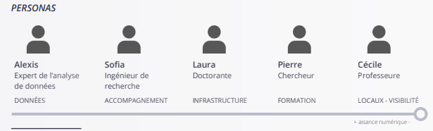
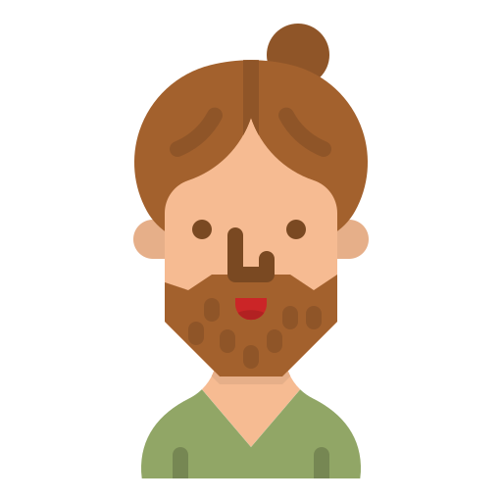


RQ1: What are the needs and requirements for (humanities) researchers to work with web archives?
2) Semi-structured interviews (2/3)
• Bart - post-doc researcher in communication sciences
• Febe - PhD-student in computational linguistics
• Ben - 35-year old journalist working for the newspaper
• Manou - 28-year old scientific researcher @ KBR
• Jan - 68-year old former team coordinator
Five personas are described in order to help with “(…) l’identification et à la définition des profils des usagers potentiels” (Moiraghi, 2018, p. 38).
Fig. 1: Overview personas Corpus-project @BnF
Fig. 2: Overview personas BeSocial project @KBR
BART FEBE BEN MANOU JAN
Notes:
In the literature we found some persona-descriptions that could function as inspiration and a guideline. For our personas we were inspired by:
• The personas created in the Corpus project and outlined in the deliverable ‘Le projet Corpus et ses publics potentiels. : Une étude prospective sur les besoins et les attentes des futurs usagers’³. In this deliverable, five personas are described in order to help with …. See slide
Based on the above, and taking group discussions and the results of the PROMISE project into account, five persona were created that could be used to start the recruitment process;

Slide 27
RQ1: What are the needs and requirements for (humanities) researchers to work with web archives?
2) Semi-structured interviews (3/3)
Using these 5 personas as an “ideal” we explored our personal and professional networks to find suitable interviewees and contacted them using email.
6 interviews were conducted in 2021
Interview guide (using both pre-defined and open questions) encompassed 3 main themes: selection, consultation and involvement & support
Notes:
A full description of these 5 personas is provided in Annex. Using these five persona as an ‘ideal’ we explored our personal and professional networks to find suitable interviewees and contacted them using e-mail. In total 6 interviews were conducted:
All participants were interviewed using conference call software (due to the covid19 restrictions). The interviews were semi-structured, using both pre-defined and open questions. Each interview was tape-recoded with permission, transcribed and analysed. The semi structured interview guide encompassed 3 main themes:
• Selection: questions on what kind of content interviewees would like to see harvested and archived, to what extent, with which frequency etc.
• Consultation: questions on how interviewees would like to explore, consult and analyse content in a social media archive
• Involvement & support: questions on how interviewees envision their involvement in social media archiving strategies and how they would like to be supported by the archiving institute

Slide 28
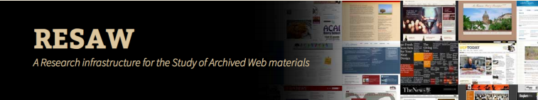
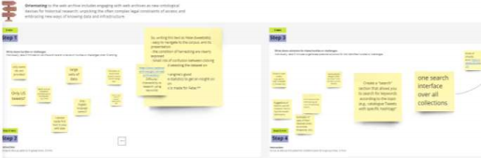
RQ1: What are the needs and requirements for (humanities) researchers to work with web archives?
3) Pre-conference workshop @RESAW (n=15)
“Title: User requirements for working with social media web archives”
Workshop structure:
1) General introduction & context;
2) Four interesting speakers shared insights on what it means to preserve (social) media content and on what is takes to use (social) media content as research data 3) Hands-on workshop via break-out rooms: Users pick a “BeSocial-Person”
and decide in group on a web-archive use case and reflect on it from
their persona for three separate phases (orientating/auditing/constructing)
Fig. 3: Overview of some of the
workshop results on ‘orientating’
Notes:
The workshop was structured in 3 parts. First Sally Chambers and professor dr. Niels Brugger quickly introduced and describe BESOCIAL and WARCNet to the participants in order to introduce the context. Next, we had three interesting speakers lined up who will offered the participants some insights on what it means to try to preserve social media content and on what it takes to use social media content as research data. The last part constituted of an hands-on workshop that took about an hour and that used online break out rooms and an interactive visual dashboard on Miro. For this last part we had about 15 international participants with profiles ranging from archivist, preservation officer or information manager to post-docs and scientific researchers.
For the hands-on workshop participants were ask to pick a BESOCIAL persona and to take on the role of one of the given BESOCIAL personas and to reflect, discuss and elaborate on the hurdles, but also opportunities, that this persona would encounter when accessing or working with archived social media data. These 5 personas were then introduced to the participants (they were also provided with a full one-pager on the persona that they selected) and they were also briefly instructed on how to use Miro⁹in case they were not familiar with this online visual collaboration platform.
Once the break-out sessions of about 7 persons each were started, each group was also asked to pick a (social media) web archive as a case to discuss. They could opt for e.g. the institution one of the participants was working for, a best-practice example, or one of the archives provided by us, namely: ⁷https://www.resaw2021.net/
⁸https://cc.au.dk/warcnet/
⁹https://miro.com/app/dashboard/
14
• https://tweetsets.library.gwu.edu/datasets
• http://webadmin.oszk.hu/solrwayback/
• http://www.nationalarchives.gov.uk/webarchive/
• https://www.webarchive.lu/covid-19/
• http://data.webarchive.org.uk/opendata/ukwa.ds.2/#issues
• https://netpreserve.org/projects/collaborative-collections/
In the end, one of the participating groups decided to focus on the use case of http://data.webarchive.org.uk/opendata/ukwa.ds.2/ while the other group opted for the use case of https://tweetsets.library.gwu.edu/datasets. Finally, participants were asked to discuss and reflect on this use-case (from the viewpoint of their persona) for three separate phases (orientating / auditing / constructing). These three conceptual phases or devices describe common research practices and associated challenges when undertaking web archival research (Ogden and Maemura, 2021). A two-folded approach was used; first, to write down hurdles or challenges for that phase & discuss these, next, to answer the ‘How might we solve this?’- question for the identified hurdles or challenges (individually and in group). The break-out sessions reconvened after about 45 minutes to plenary share their insights.

Slide 29
RQ2: What knowledge, values and skills are needed for (humanities) researcher to work with web archives?
=> How can I help social media archives in serving their users with the right tools, functionalities etc?
I want to design an instrument/scale to measure the competencies and needs of the users by following a multi-phase scale development approach (DeVellis, 2012):
Phase 1: Item generation and scale development phase
Phase 2: Testing phase
Exploratory & confirmatory factor analysis
Item convergent validity & internal consistency
Notes:
How can we help social media archives in serving their users with the right functionalities?

Slide 30
RQ2: What knowledge, values and skills are needed for (humanities) researcher to work with web archives?
1) Item generation and scale development
Step 1 | Literature review | Inventory of XX items | Searching for studies describing forms of literacies, skills and competences for researchers working with (web) archived content and how these modes conceptualized, described and measured
Step 2 | Expert panel review 1 | Preliminary version of scale (XX items) | Reformulation of the items to better fit into the context and technological affordances of web archives
Step 3 | Expert panel review 2 | Qualitative assessment of scale | Evaluation the different items of the scale in terms of wording, grammar, scaling and item allocation
Step 4 | *New* expert panel review | Quantitative assessment of scale | Rating of the items in terms of relevance, clarity and simplicity
Notes:
How can we help social media archives in serving their users with the right functionalities?

Slide 31
RQ2: What knowledge, values and skills are needed for (humanities) researcher to work with web archives?
2) Testing
Development of a questionnaire (or include in an existing survey):
Include the items of WAIS (see phase 1)
Collect socio-demographic characteristics
Statistical analysis to test the psychometric properties of WAIS:
Construct validity: exploratory and confirmatory factor analysis
Item convergent validity
Internal consistency (reliability)
Notes:
How can we help social media archives in serving their users with the right functionalities?

Slide 32
Thank you!
Eveline.Vlassenroot@UGent.be

